Slide 1

Delivery Centers Data Warehouse
Atharva Khaire
U15258568

Slide 2
Dataset Description
Source 1: Brazilian Delivery Center Dataset
https://www.kaggle.com/datasets/nosbielcs/brazilian-delivery-center
Source 2: Brazilian Cities
https://www.kaggle.com/datasets/crisparada/brazilian-cities

Slide 3
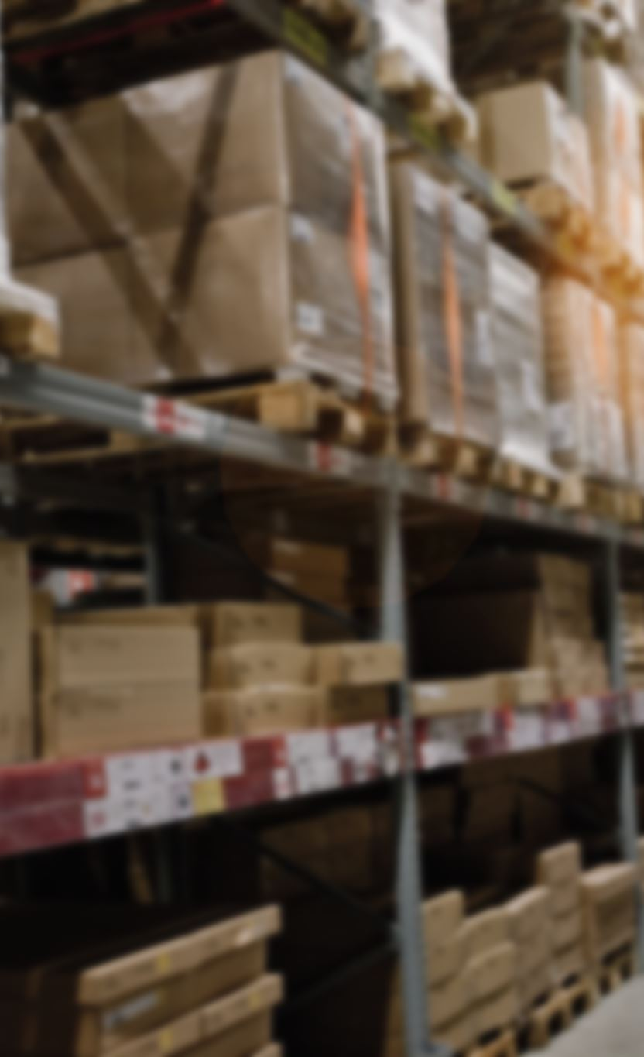
Brazilian Delivery Center Dataset
Aspects –
Channels: The marketplaces (sales channels) where the products and food of the merchants are sold.
Deliveries: The deliveries made by the partner couriers.
Drivers: The couriers who work with the centers. Every time an order is processed, they are stationed in the hubs and are in charge of delivering orders to customers' houses.
Hubs: The order distribution centers, or hubs, are where deliveries are sent out from.
Orders: The purchases made through the Delivery Center platform.
Payments: The payments made to the Delivery Center.
Stores: Data about the retailers. They advertise their products (goods and/or food) on marketplaces by using the Delivery Center platform.

Slide 4
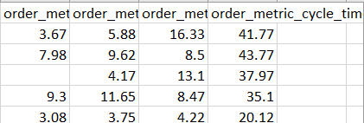
Initial Flat Table

Slide 5
Brazilian Cities
Aspects
City
State
Capital
Population
Note: There are more attributes in the dataset but we will be taking into account only the above four.

Slide 6
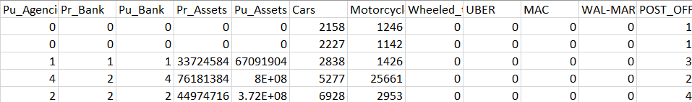
Cities Table

Slide 7
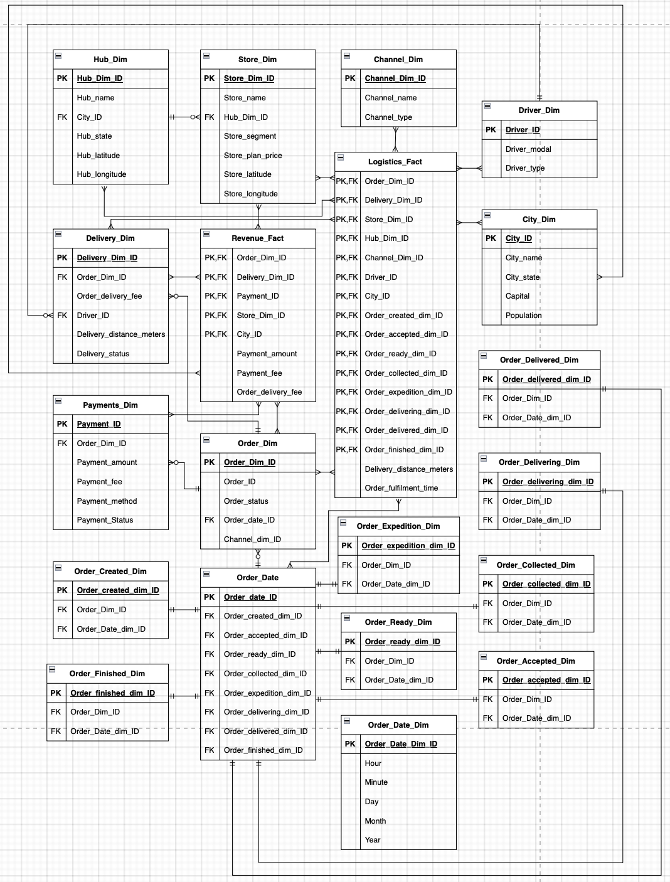
Proposed Data Warehouse Schema

Slide 8
Business Questions
What is the average order fulfillment time for each channel in each store segment?
What is the revenue generated in store segments in each city?
What is the revenue generated by each store branch in each city?
What is the order cancellation percentage for each store?
What is the total order delivery fee charged by drivers in each city?
What is the percentage of online transactions as compared to other payment methods?
What is the average delivery distance an order was carried from a store in each store segment?
What is the average production time each store required?

Slide 9
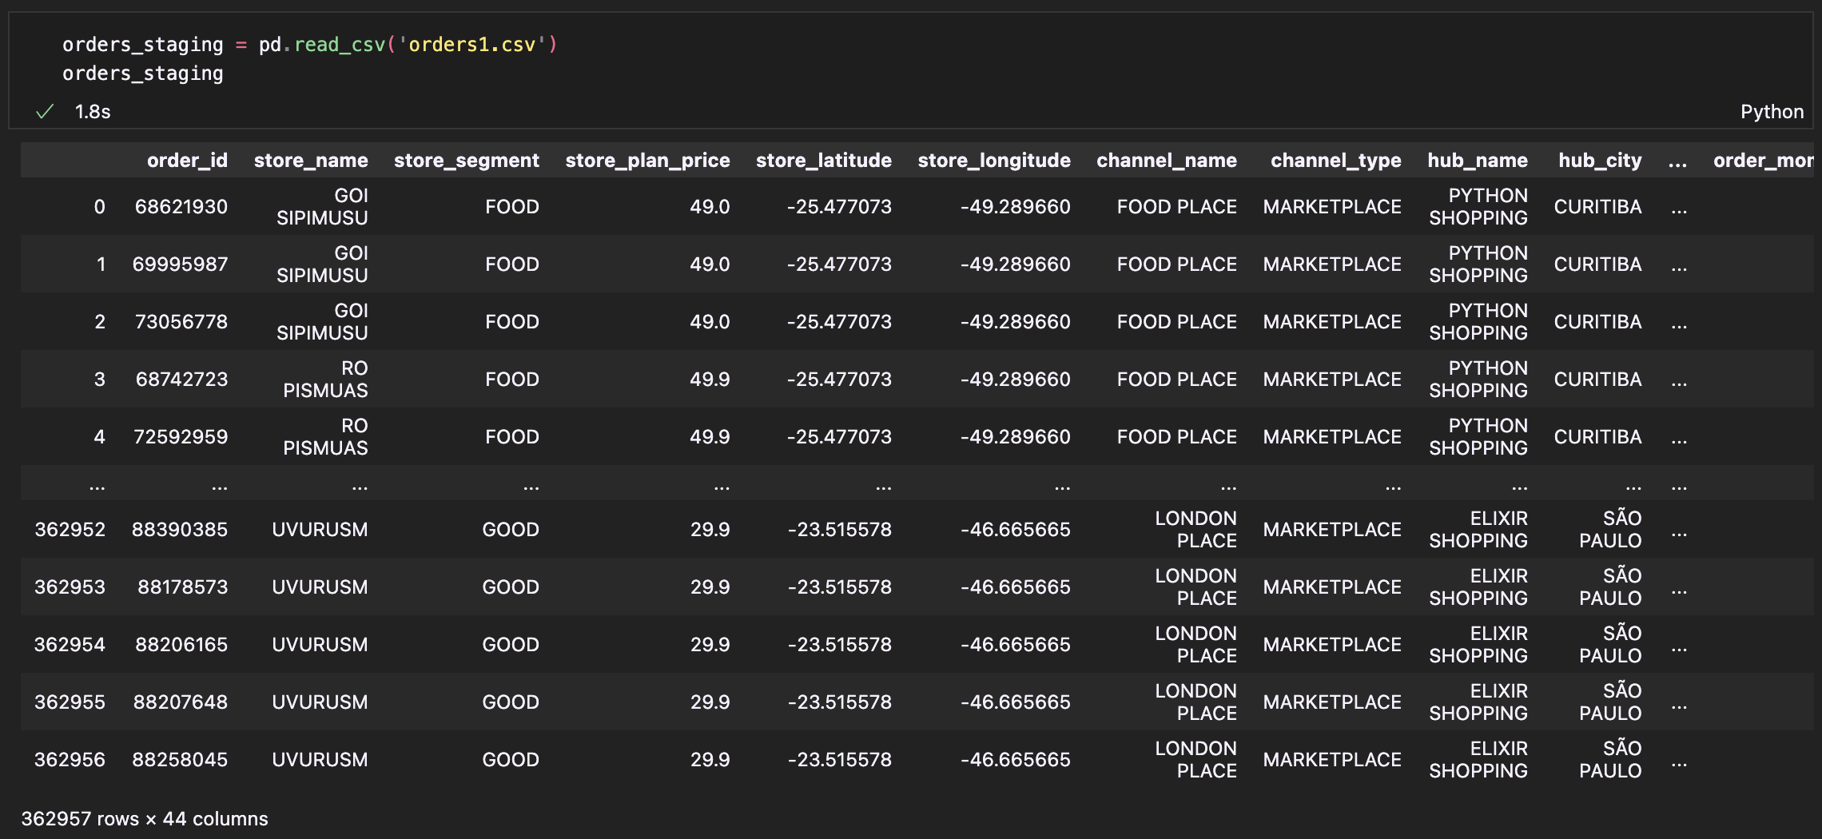
Extract Phase(Orders_Staging)
Loading the delivery center dataset into a dataframe.

Slide 10
Transformation Phase
In the Orders_Staging table, we notice that there are multiple timestamp attributes like order_moment_accepted, order_moment_ready, order_moment_delivered etc.
Basically, these denote the timestamps of various stages through which an order is fulfilled.
Now, when we have to calculate certain measures for analysis, it is better to have every component of the timestamp in a separate column.
Hence, we perform a transformation on these attributes using a python function.

Slide 11
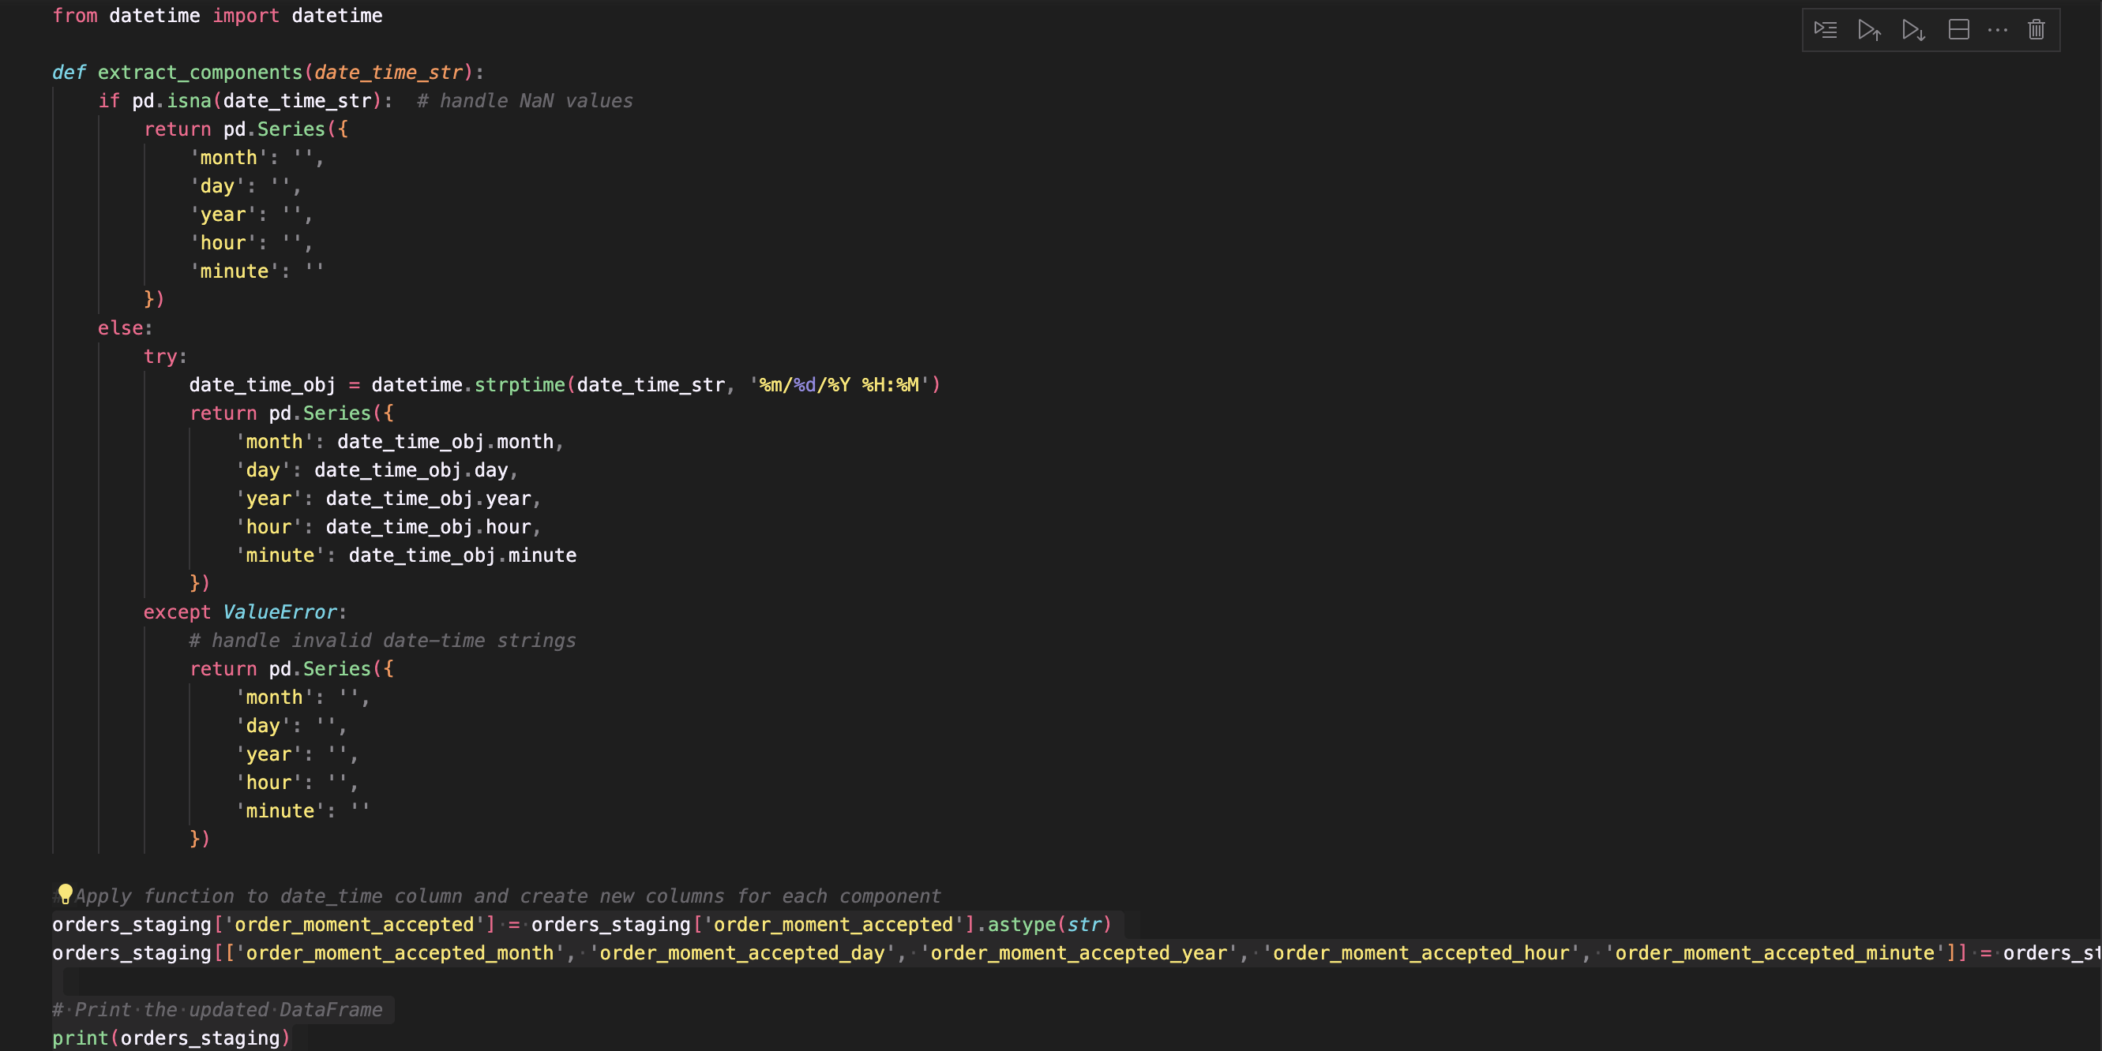
Python Code used for Date Transformation

Slide 12
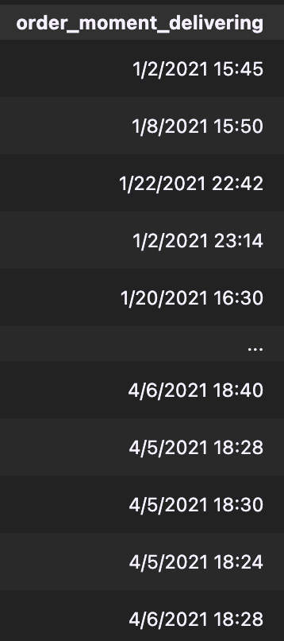
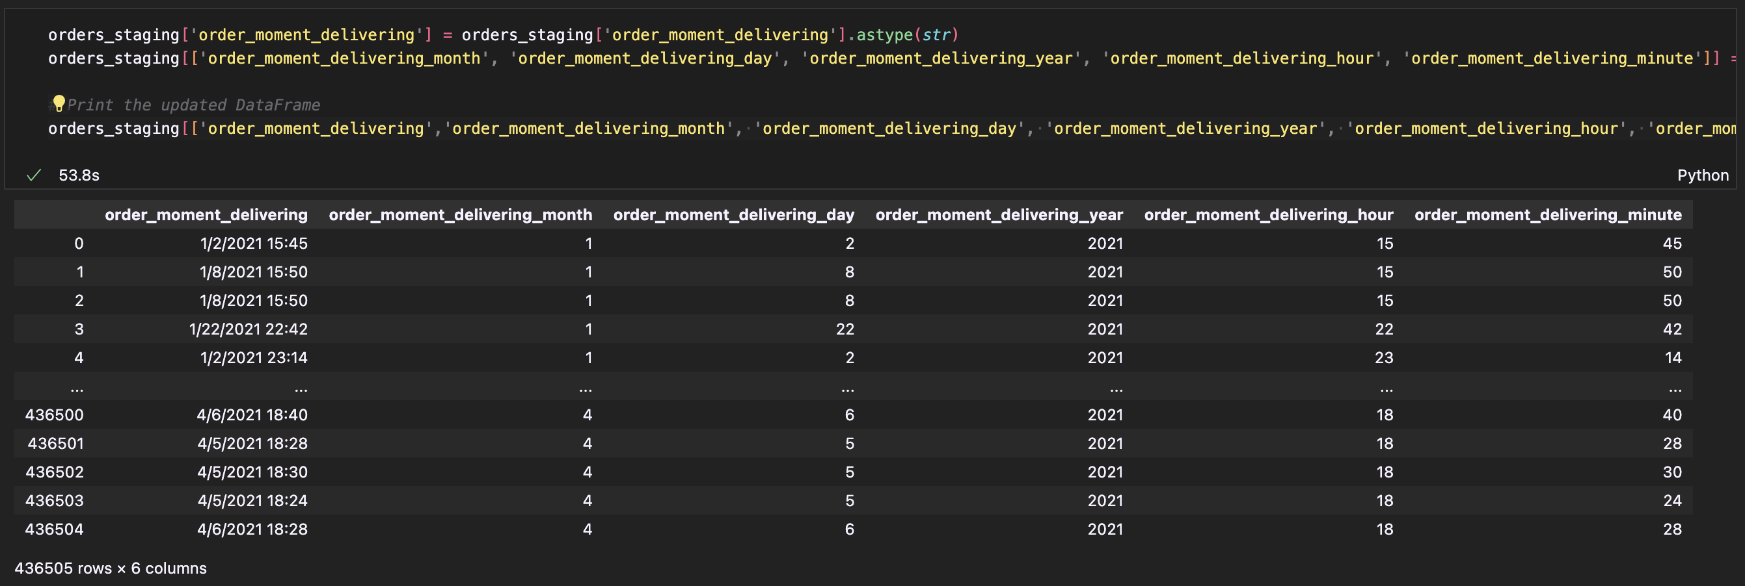
Attributes prior to and after Transformation

Slide 13
Breaking down staging table into Dimensions
If we look at our staging table, we can see that all the aspects of the dataset are just presented through attributes without any IDs or references.
Therefore, we need to breakdown individual aspects into different dimension tables.
For example, Store Dimension will contain attributes pertaining to the store details. These attributes include Store Name, Store Segment, Store Plan Price, Store_Latitude, Store Longitude.
So, the way we break down each dimension is first subset the dataframe for relevant attributes and store them in a different dataframe and from there assign dimension IDs to uniquely save the details.

Slide 14
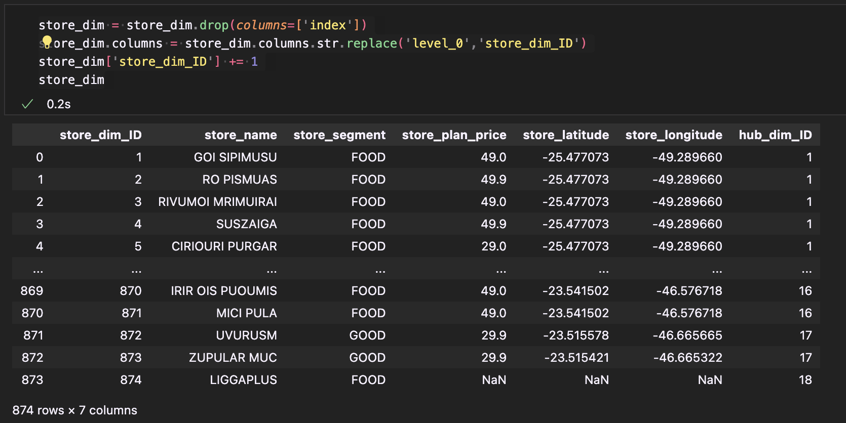
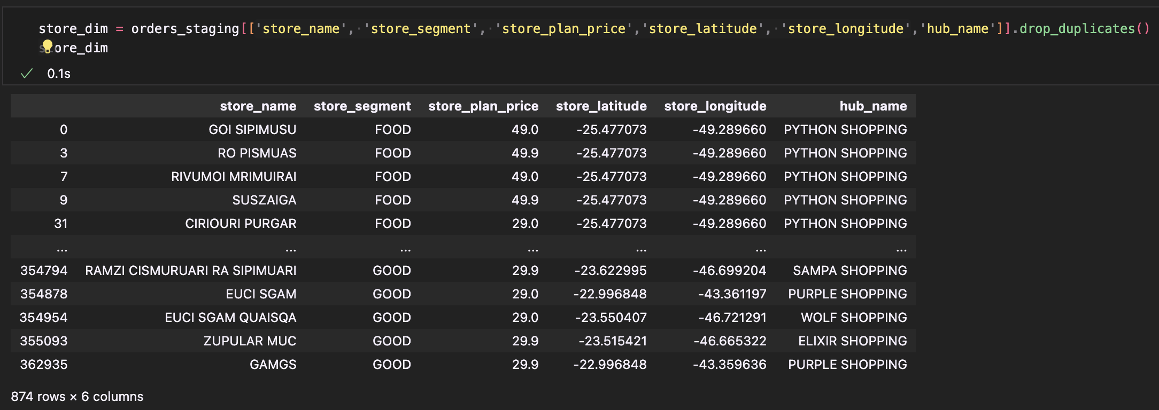
Store Dimension Breakdown
Left Image: Subset of the dataframe containing store attributes
Right Image: Final Store Dimension

Slide 15
Dimensions

Slide 16
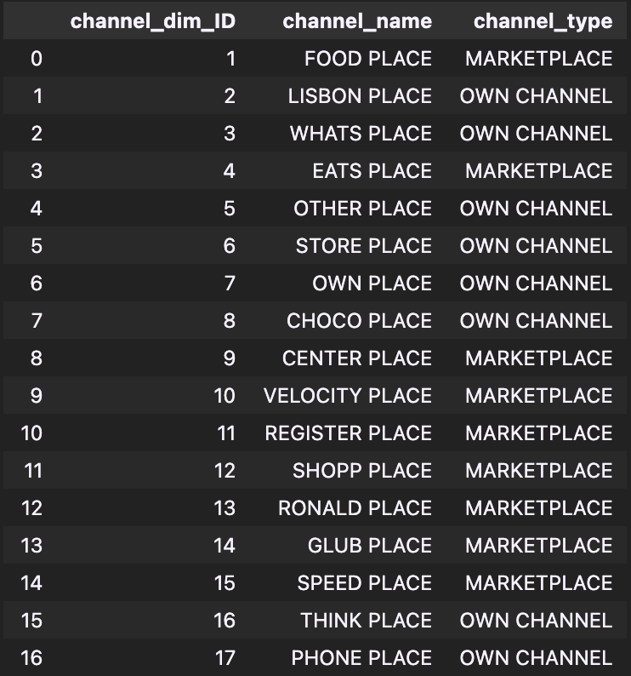
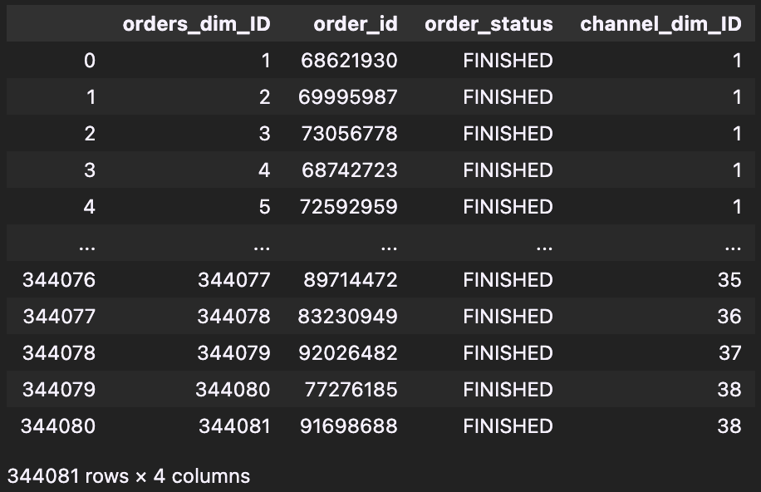
Orders Dimension
Channel Dimension

Slide 17
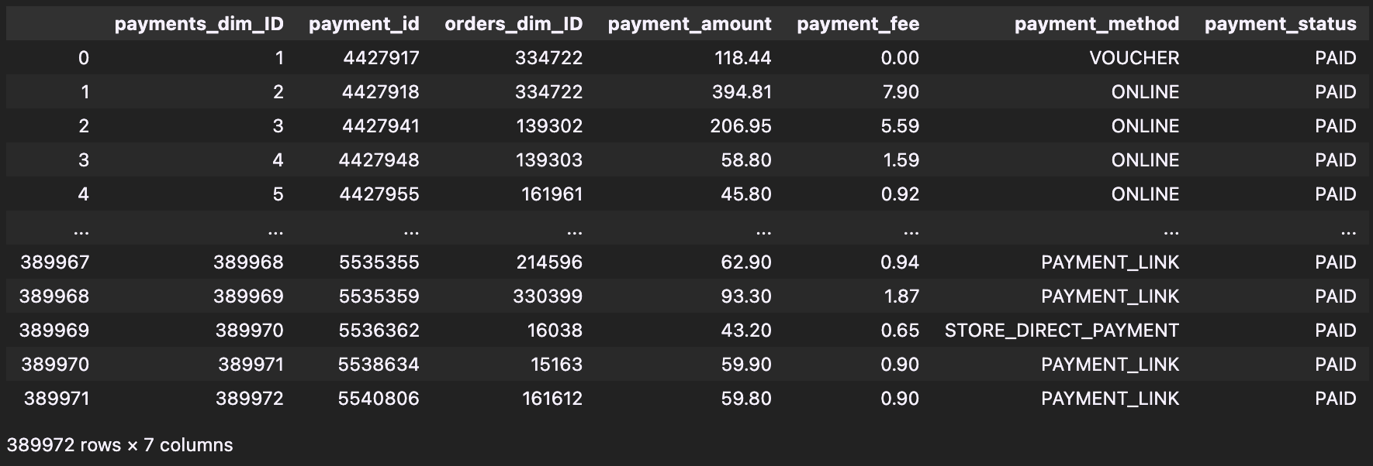
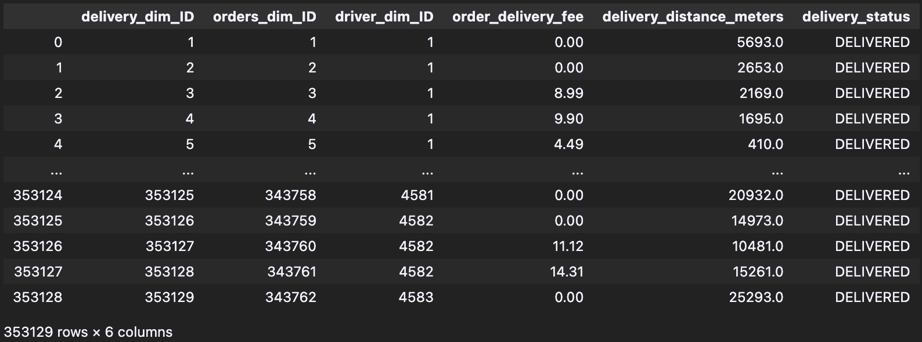
Payments Dimension
Delivery Dimension

Slide 18
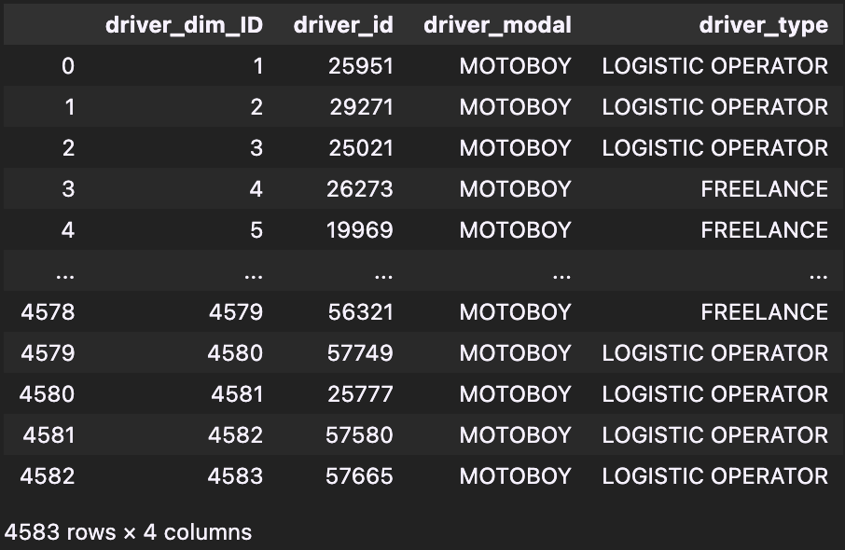
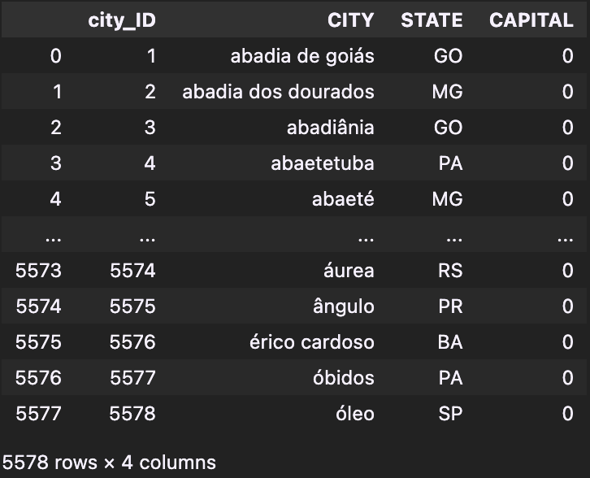
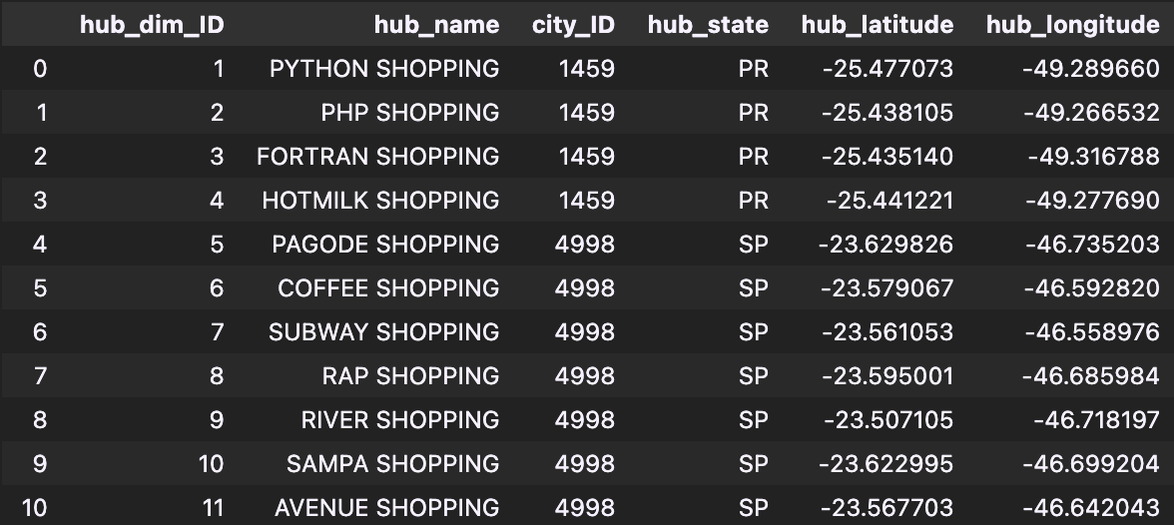
Driver Dimension
City Dimension
Hub Dimension

Slide 19

Implementing Slowly Changing Dimensions (SCD)
Deciding which dimensions need the historical data to be stored, I decided to allot SCDs –
Orders Dimension – SCD Type 2
Order details like order status, order amount etc. change all the time. Therefore, having a record and timestamp of when the data changes is key for the functioning of the warehouse.
Payments Dimension – SCD Type 2
Delivery Dimension – SCD Type 2
Driver Dimension– SCD Type 3
Historical Driver information is not important to us. Only the previous and the current data is relevant for business analysis.

Slide 20

Store Dimension – SCD Type 1
Store details rarely change. Therefore, a simple overwrite will serve us the purpose.
Hub Dimension – SCD Type 1
Channel Dimension – SCD Type 1
City Dimension – SCD Type 1
Order_Moment Dimensions – No SCD
I decided on this because if we want to update a record, we will just simply add a new record without updating the previous one.

Slide 21
Slowly Changing Dimensions

Slide 22
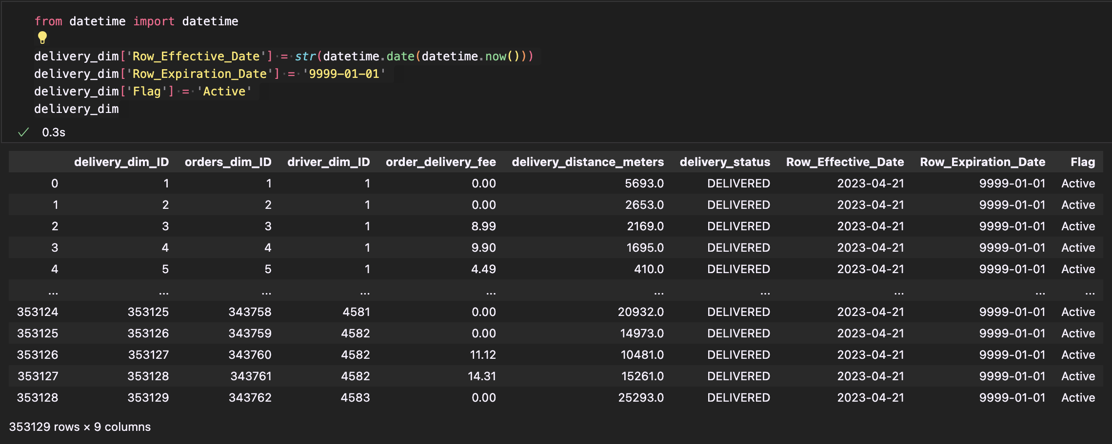
Delivery Dimension (SCD Type 2)

Slide 23
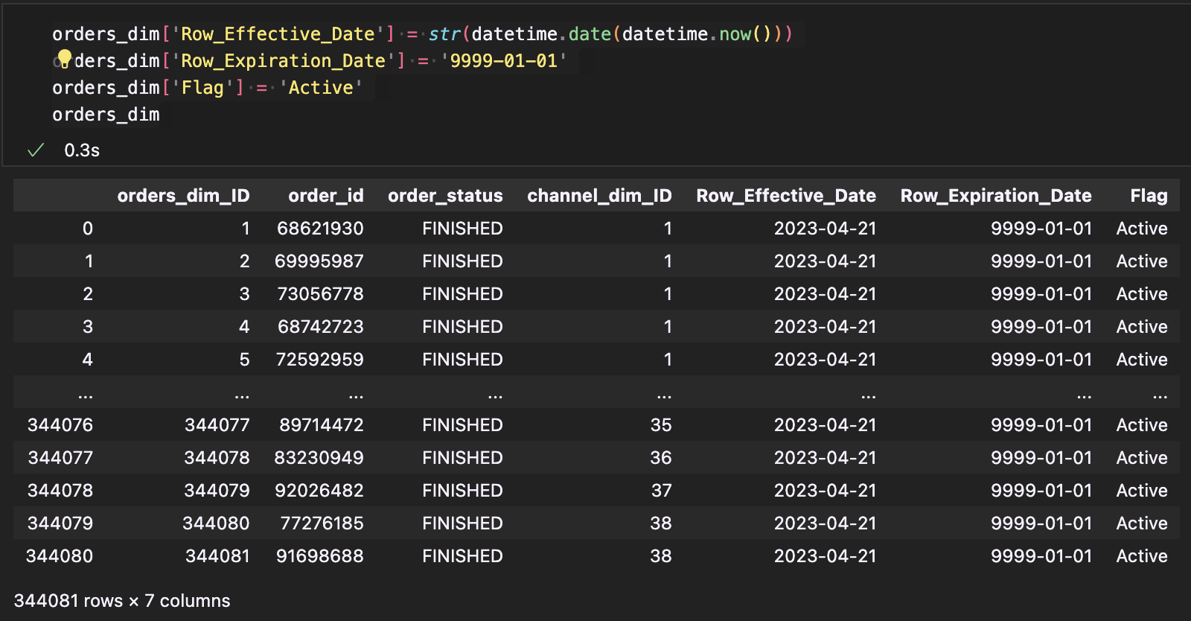
Orders Dimension (SCD Type 2)

Slide 24
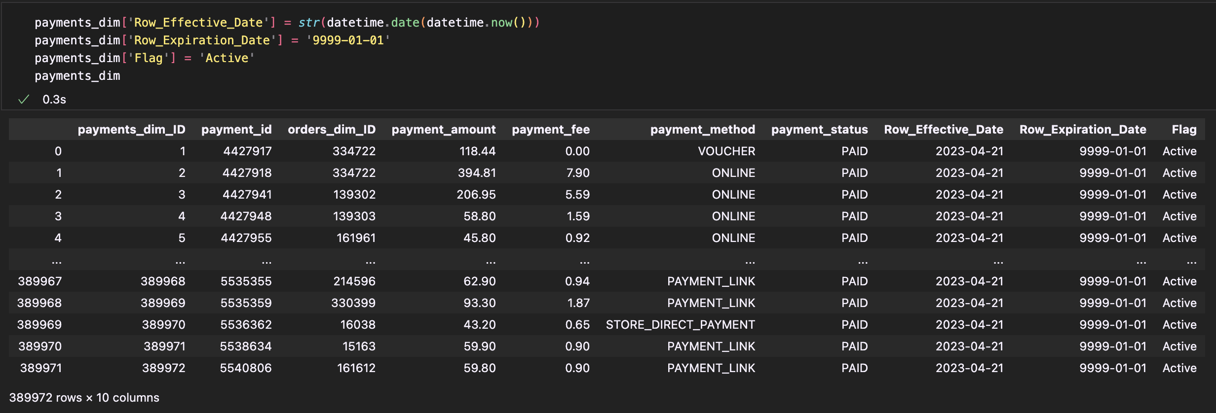
Payments Dimension (SCD Type 2)

Slide 25
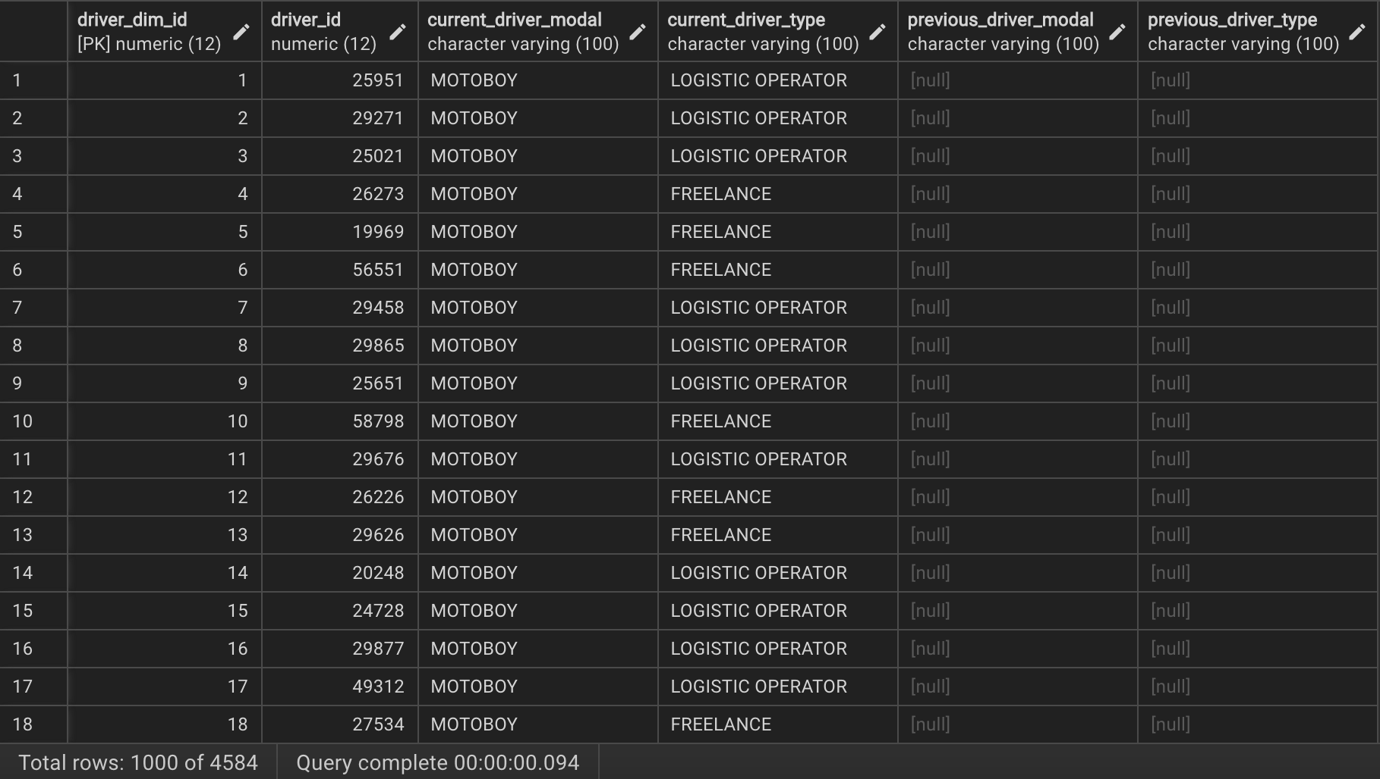
Driver Dimension (SCD Type 3)

Slide 26
Fact Table Generation
Revenue Fact Table
This table contains attributes related to money. For example, payment amount, payment fee, order delivery fee.
The purpose of the fact table is to help the company analyze different revenue streams along with the costs they have to bear to maintain their channels, hubs, drivers and stores.
Logistics Fact Table
This table contains attributes related to time and distance. For example, order moment accepted, order moment finished, delivery distance in meters, order fulfillment time.
This table’s goal is to provide analysis on how much time it takes for orders to be fulfilled along with the distance travelled for the orders to reach their customers.

Slide 27
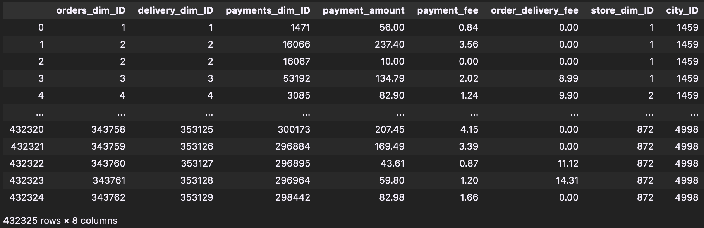
Revenue Fact Table

Slide 28
Points to note about Revenue Fact Table
Attributes: orders_dim_id, delivery_dim_id, payments_dim_id, payment_amount, payment_fee, order_delivery_fee, store_dim_id, city_id
Table formed by merging orders_staging with the relevant dimensions.
Cumulative Fact Table
No new derived or transformed measures

Slide 29
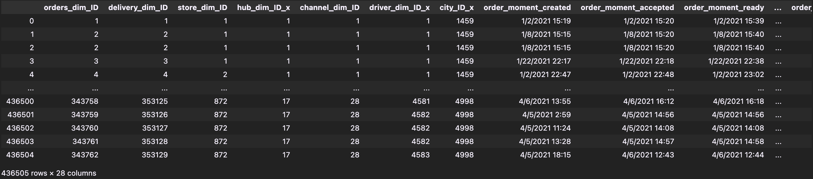
Logistics Fact Table

Slide 30
Points to note about Logistics Fact Table
Attributes: orders_dim_id, delivery_dim_id, store_dim_id, hub_dim_id, channel_dim_id, driver_dim_id, city_id, order_moment_ids, order_metric_ids, delivery_distance_meters, order_fulfillment_time(derived), order_fulfillment_time_in_minutes(derived)
Numerous derived measures
Snapshot Fact Table
Formed by merging orders_staging with all the dimensions in the proposed schema

Slide 31
Generation of Derived Measures(Logistics Fact Table)
Once all the attributes were loaded into the fact table from order staging, I wanted to calculate the order fulfillment time.
So, to do this, I subtracted the order_moment_accepted_time with order_moment_finished_time.
This gave me a timedelta type column.
I further broke down this column into days, hours, minutes columns and made a new column with order fulfillment time only in minutes.

Slide 32
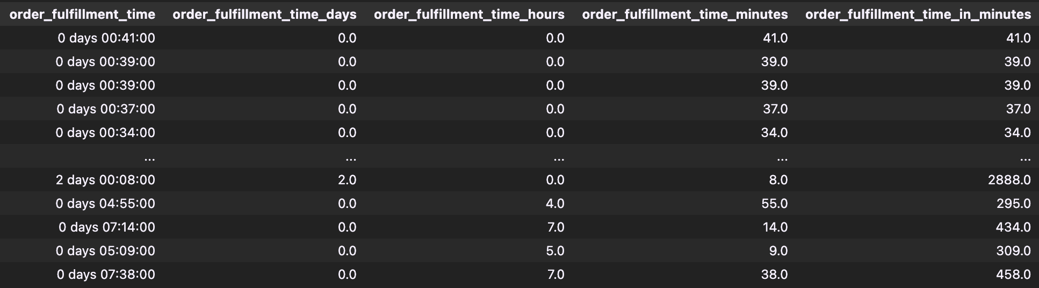
Order Fulfillment Time Attributes

Slide 33
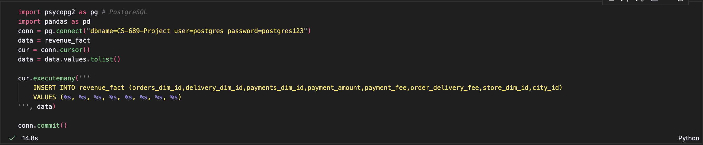
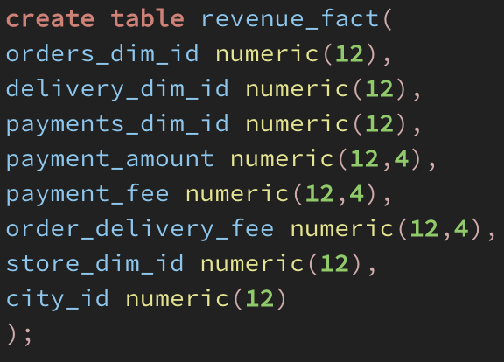
Loading Phase(Dimensions and Fact Tables)
After all the tables were in place, Dimensions and the fact tables were loaded into postgresql database.
Sample code of loading the revenue_fact table is displayed on the right.

Slide 34
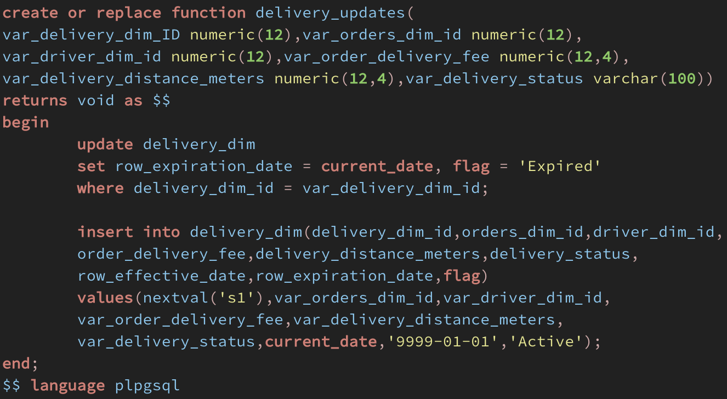
Maintaining SCDs
SQL Code for maintaining SCD type 2 on Delivery Dimension table

Slide 35
Testing Delivery Dimension SCD Type 2
Before Update:
After Update:
As you can see in the above screenshots, before updation, the row expiration date for the original record is 9999-01-01 and as soon as the update is made i.e., delivery status changed from delivering to delivered, previous row expiration date is replaced by today's date and the previous record’s flag is set to Expired.

Slide 36
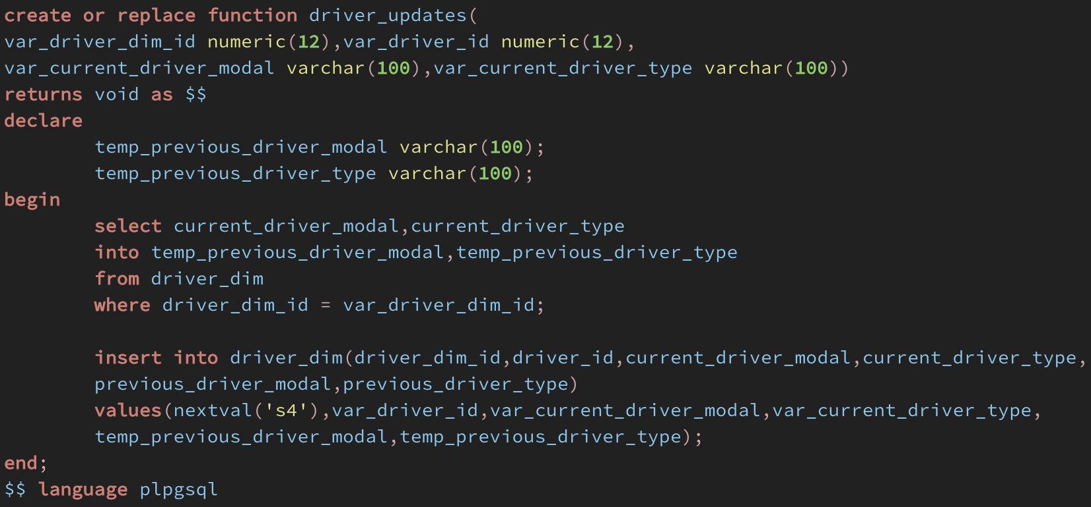
Maintaining SCDs
SQL Code for maintaining SCD type 3 on Driver Dimension table

Slide 37
Testing Driver Dimension SCD Type 3
Before Update:
After Update:

Slide 38
Business Questions

Slide 39
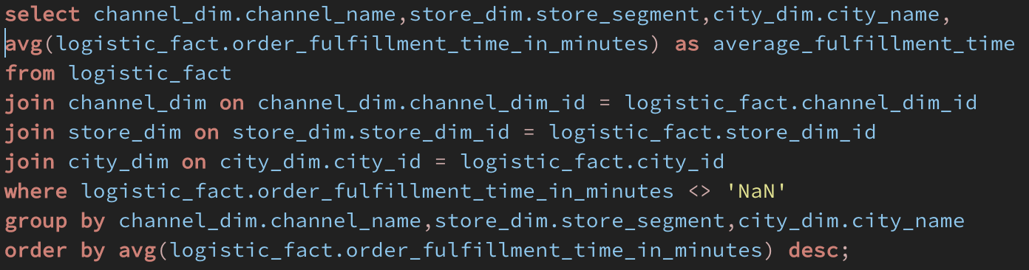
What is the average order fulfillment time for each channel in each store segment?
SQL Code

Slide 40
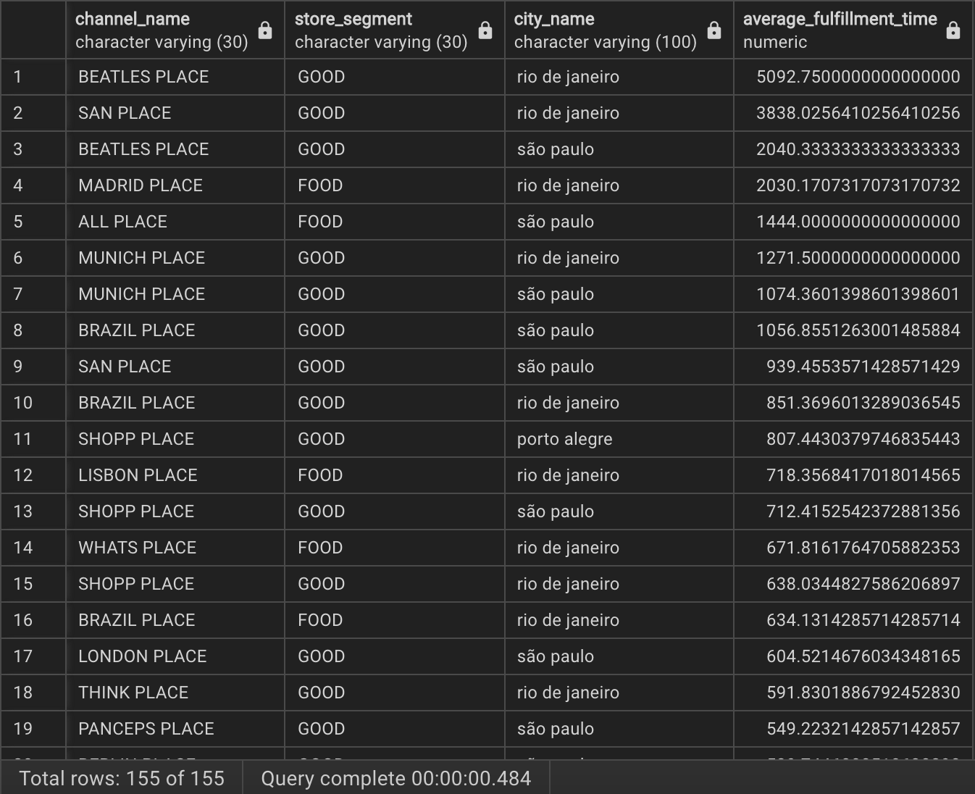
Query Result

Slide 41
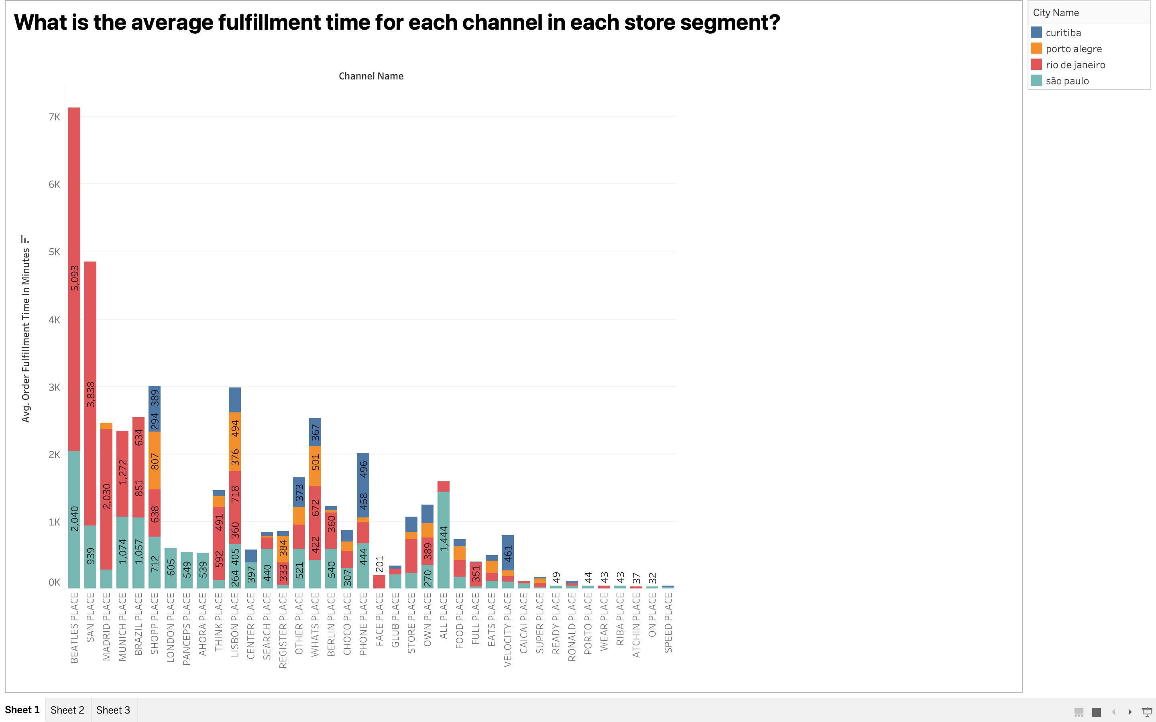
Corresponding Visualization

Slide 42
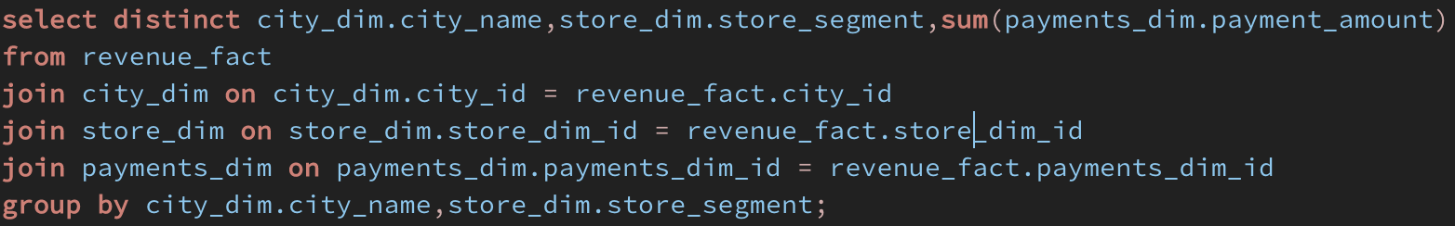
What is the revenue generated in store segments in each city?
SQL Code

Slide 43
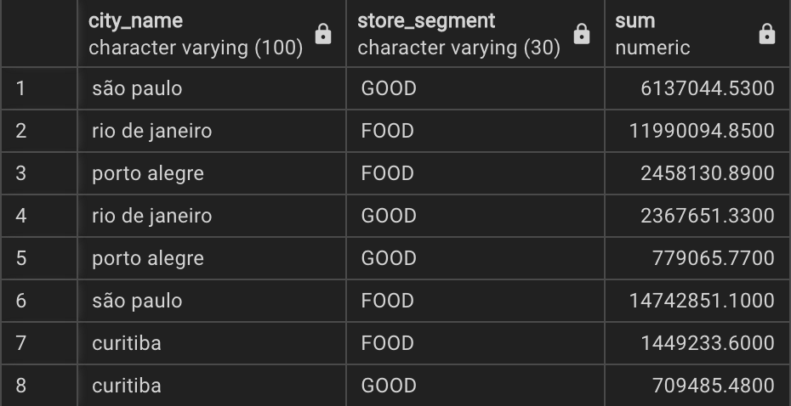
Query Result

Slide 44
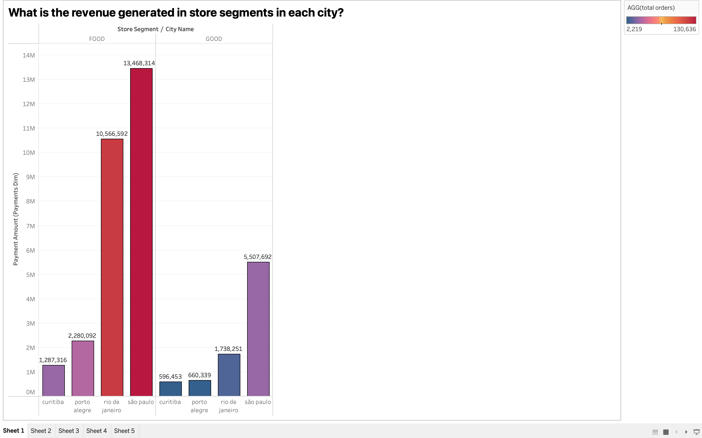
Corresponding Visualization

Slide 45
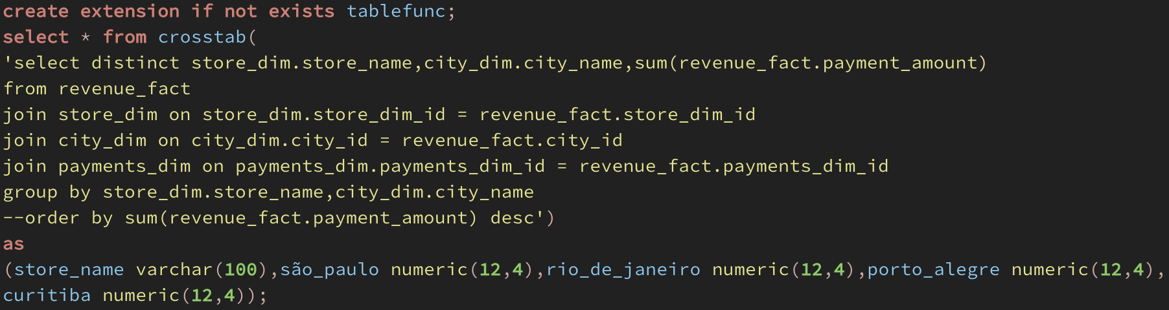
What is the revenue generated by each store branch in each city?
SQL Code

Slide 46
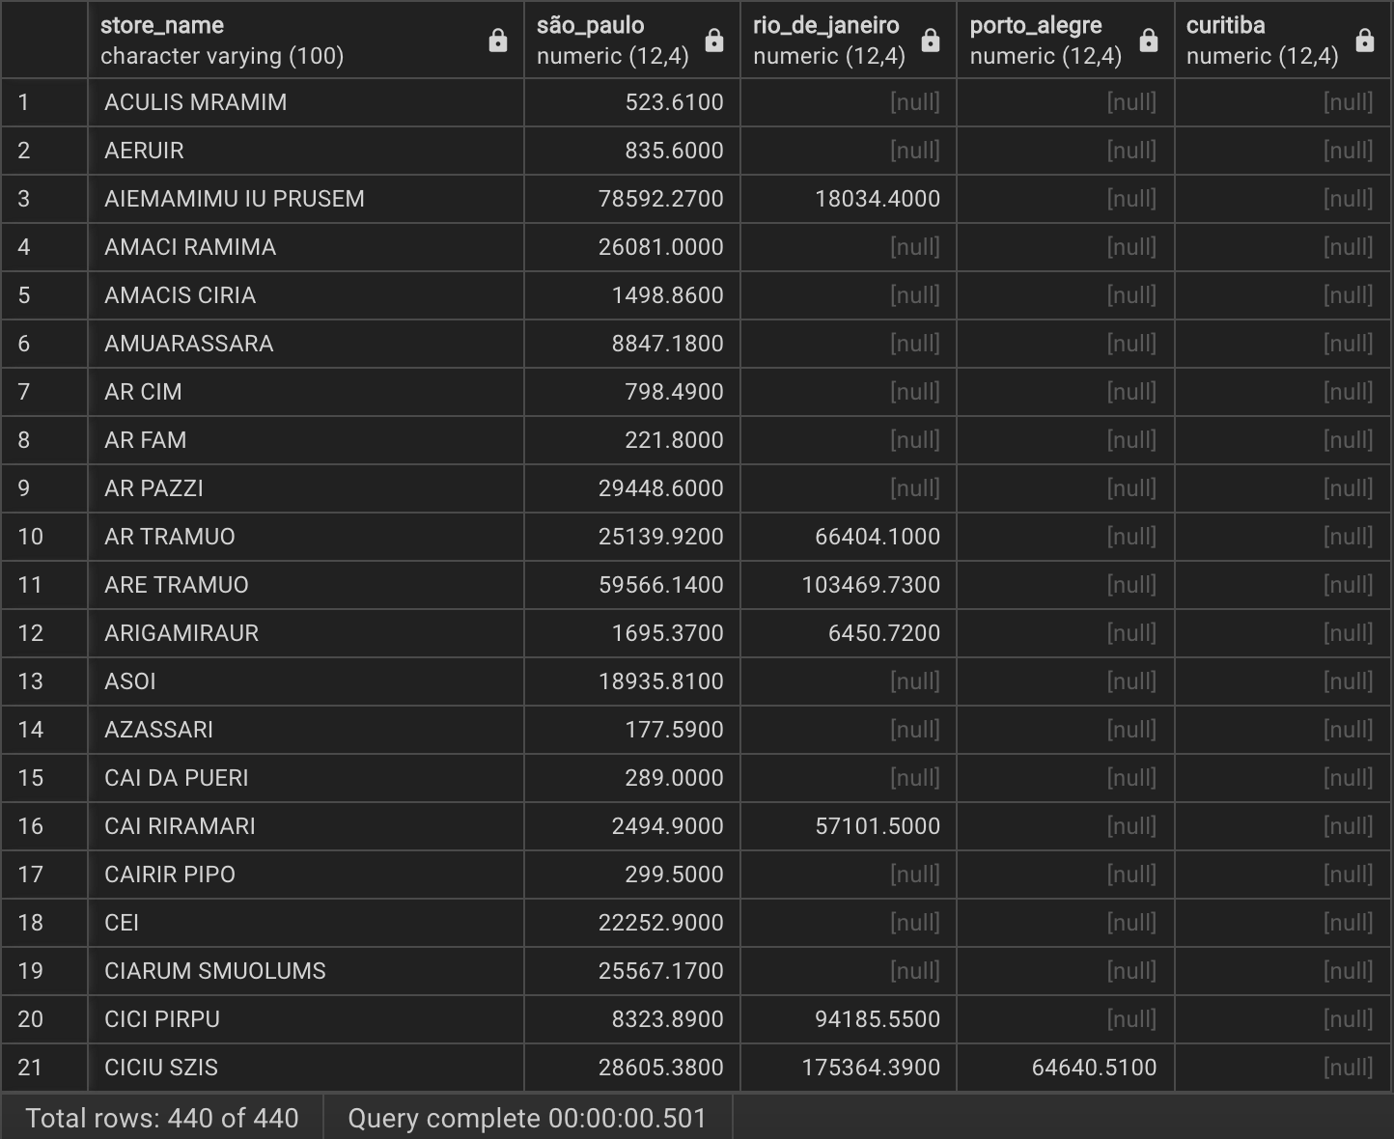
Query Result

Slide 47
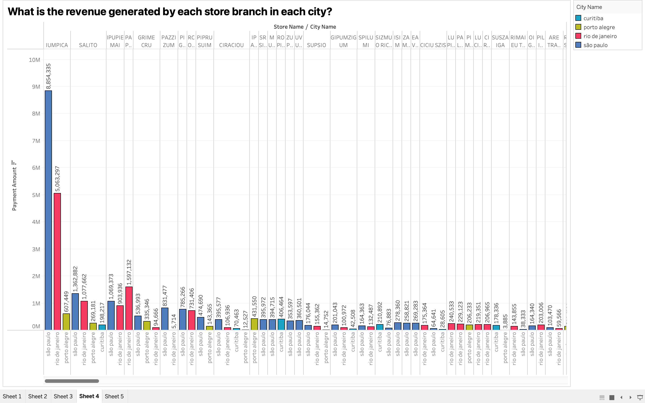
Corresponding Visualization

Slide 48
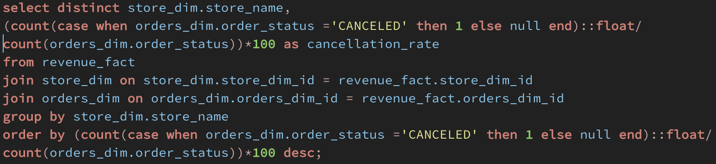
What is the order cancellation percentage for each store?
SQL Code

Slide 49
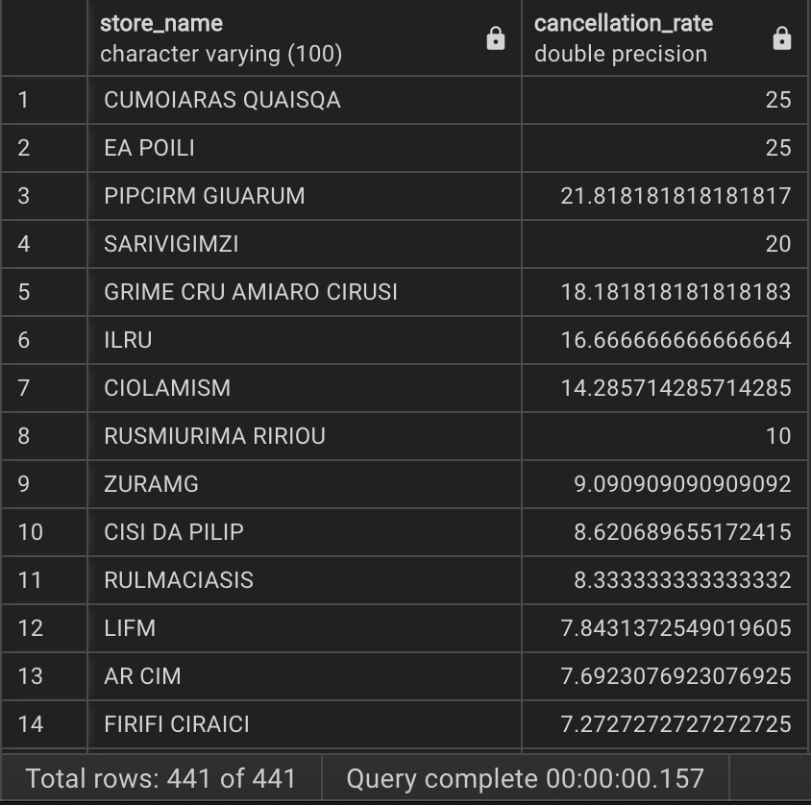
Query Result

Slide 50
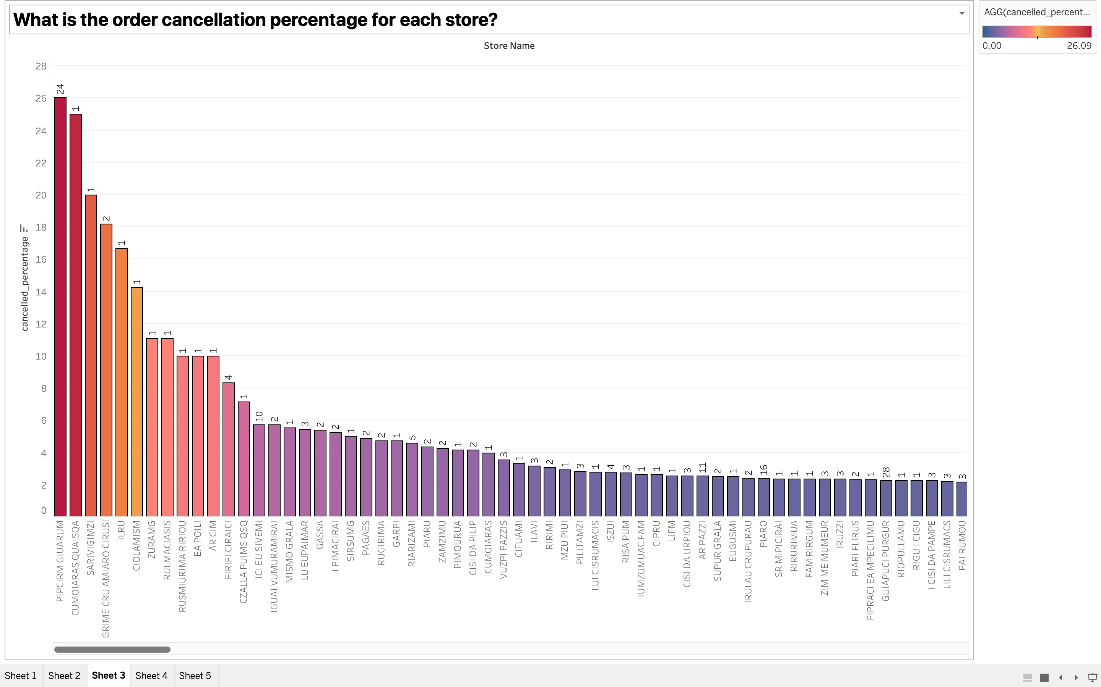
Corresponding Visualization

Slide 51
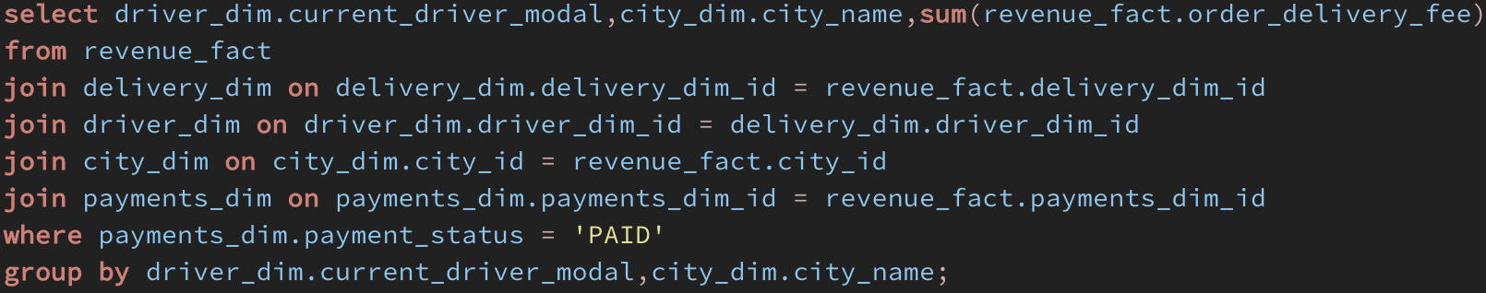
What is the total order delivery fee charged by drivers in each city?
SQL Code

Slide 52
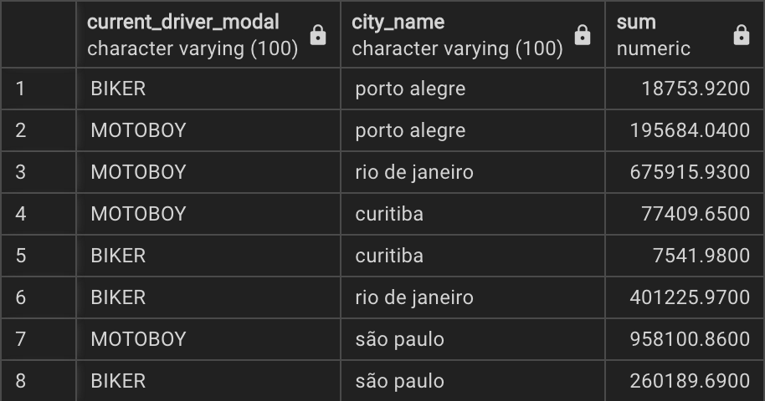
Query Result

Slide 53
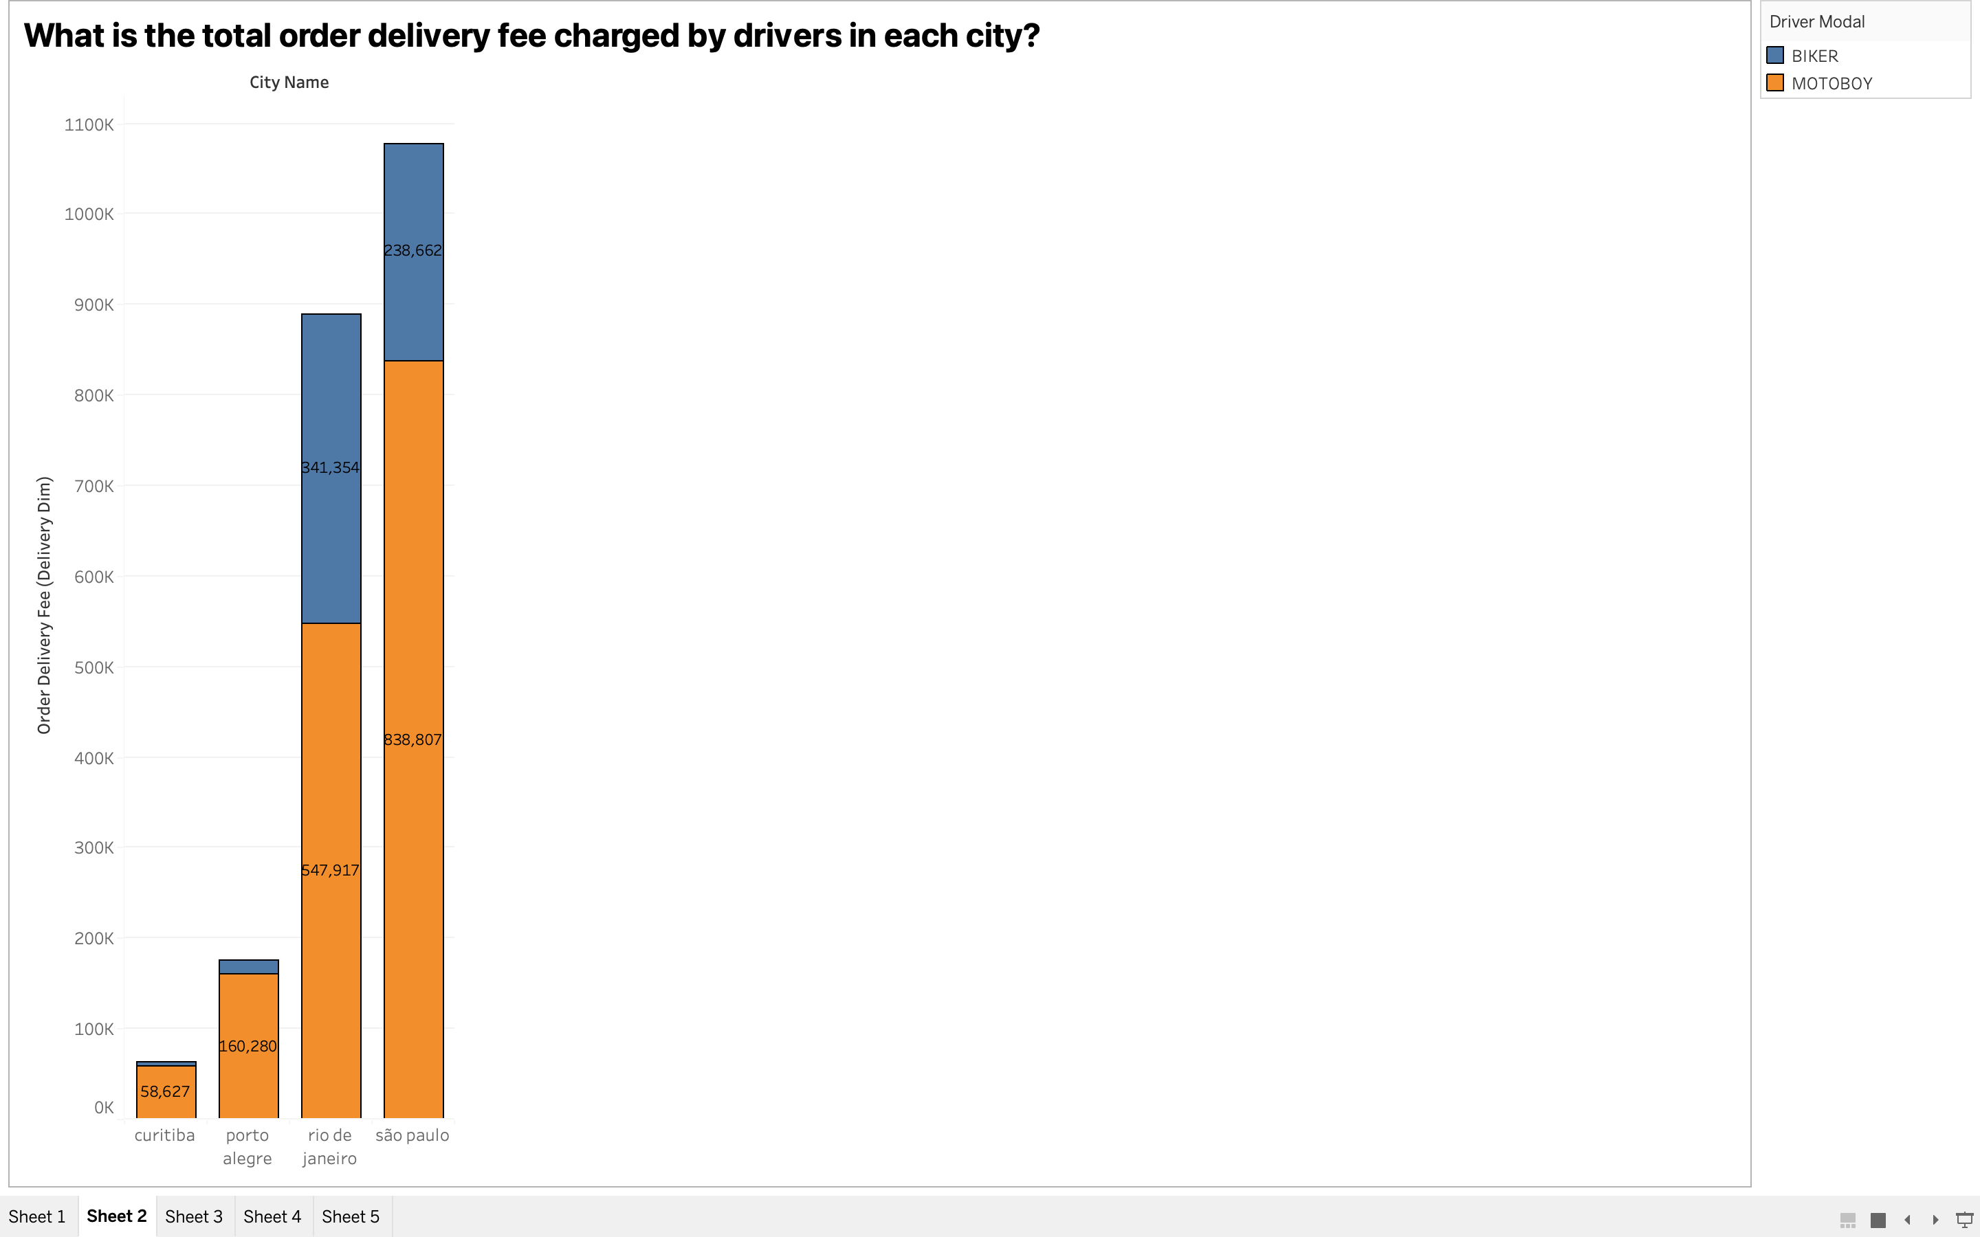
Corresponding Visualization

Slide 54
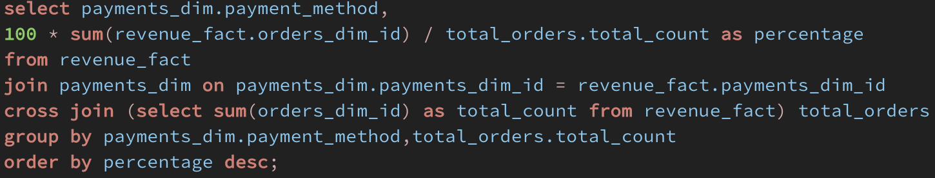
What is the percentage of online transactions as compared to other payment methods?
SQL Code

Slide 55
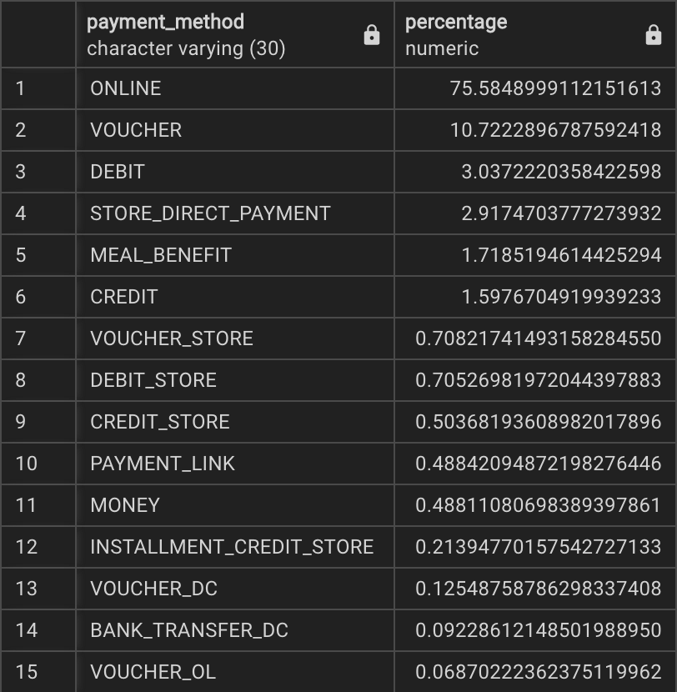
Query Result

Slide 56
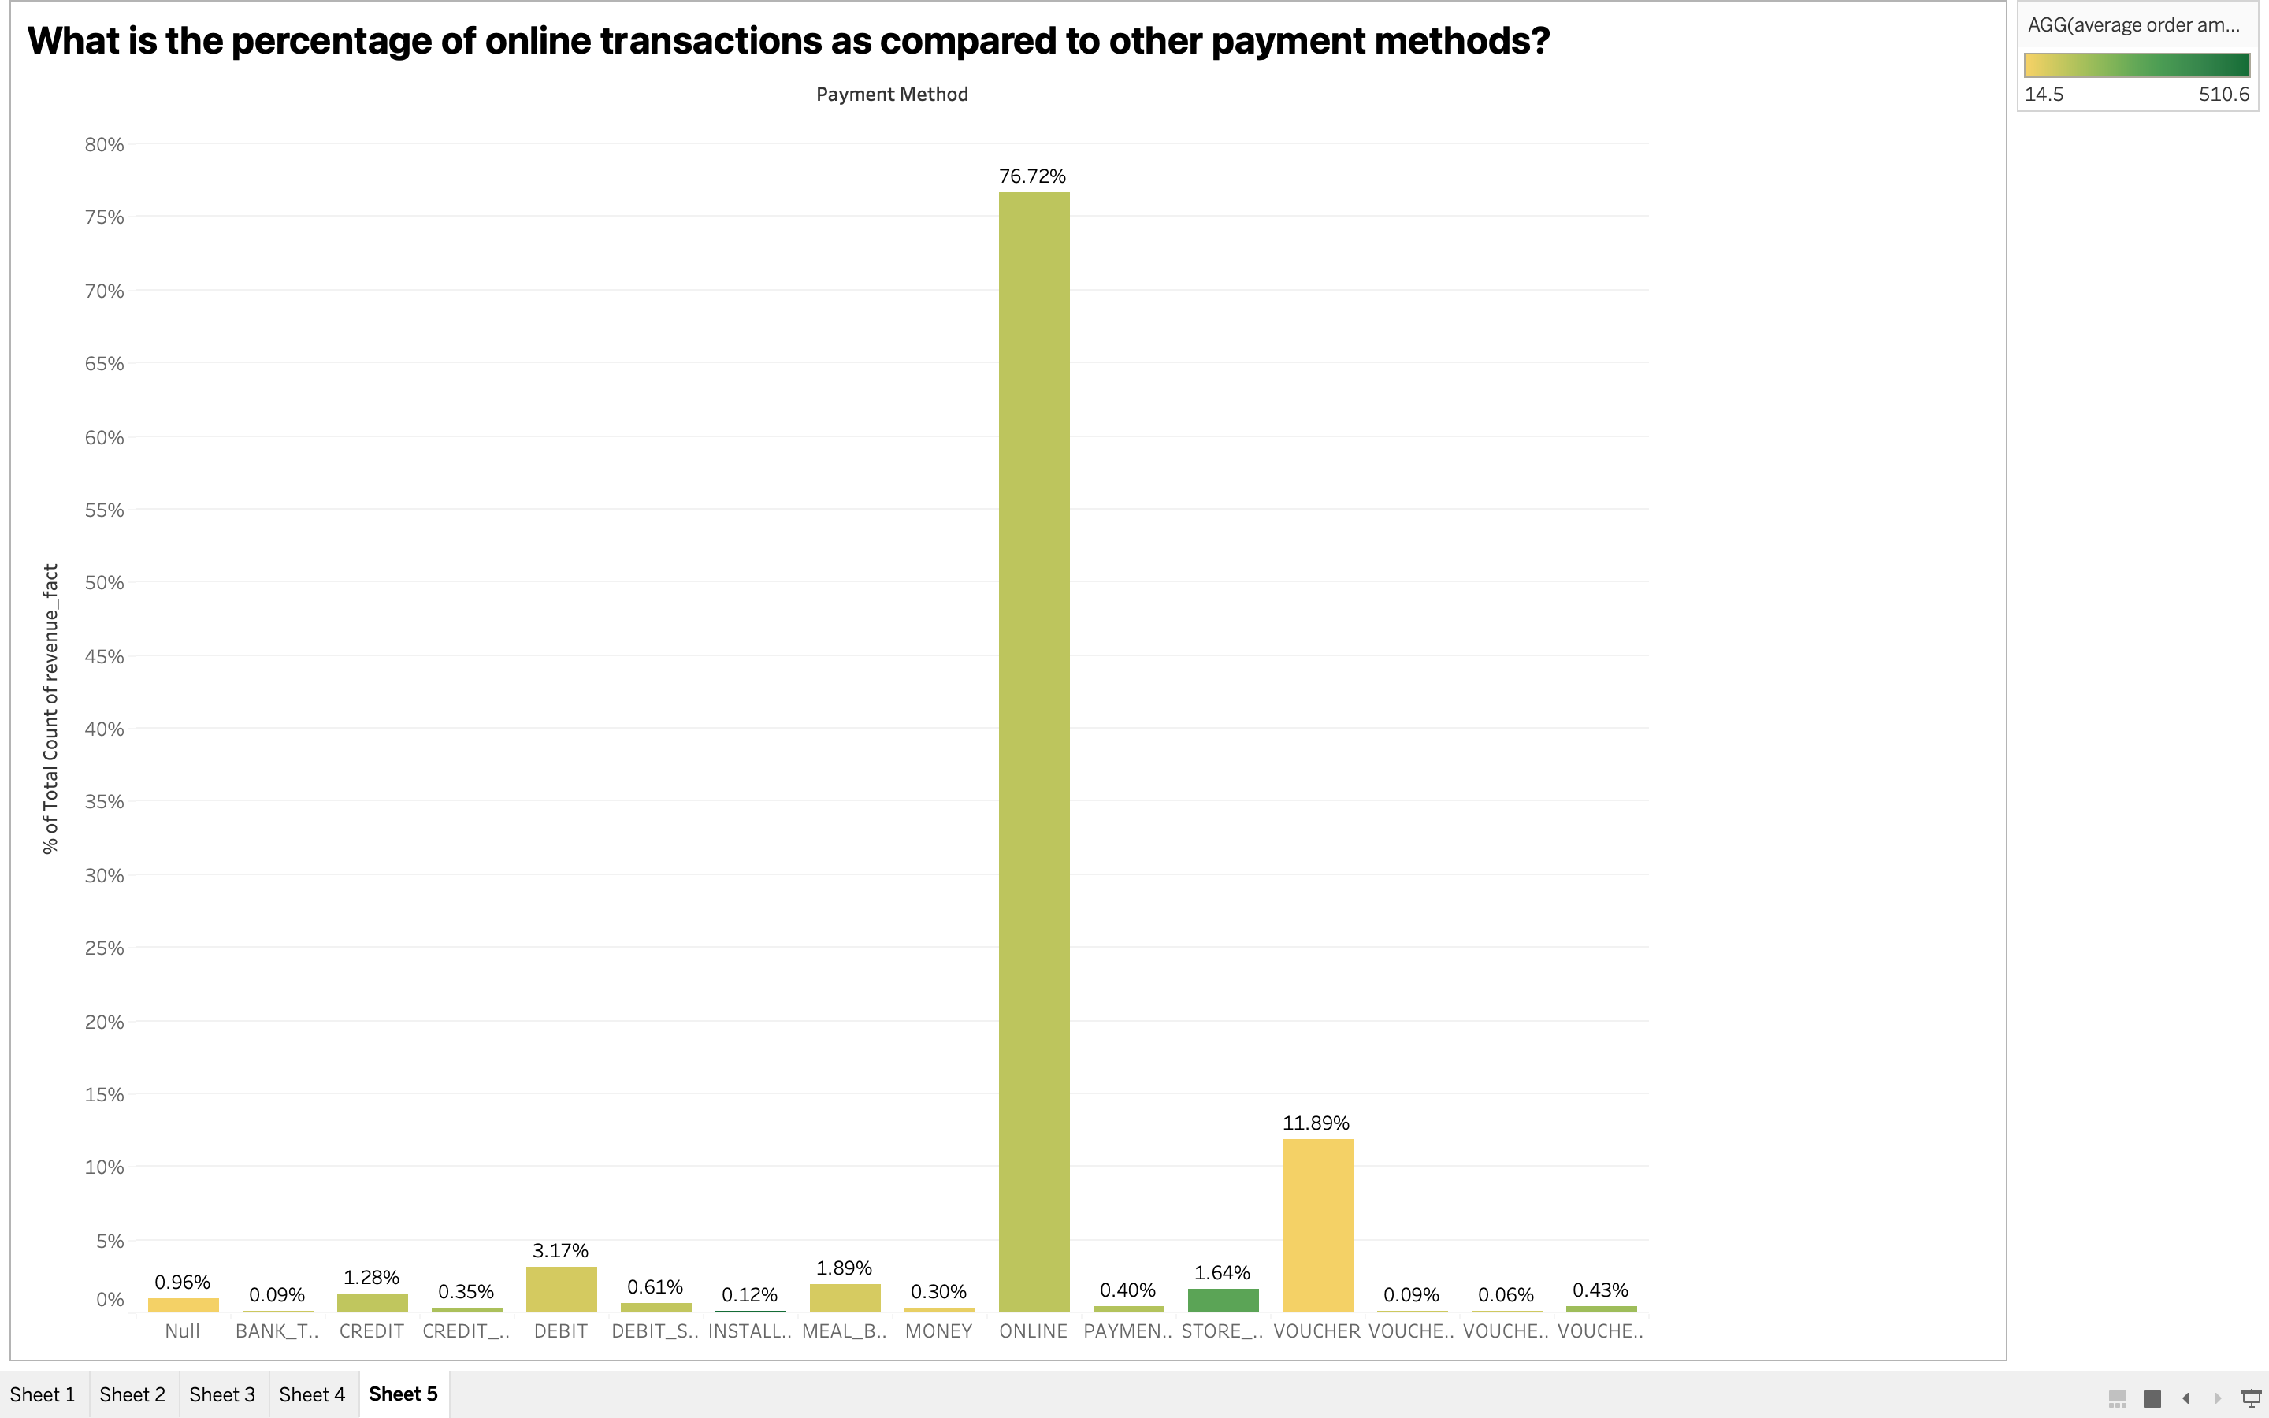
Corresponding Visualization

Slide 57
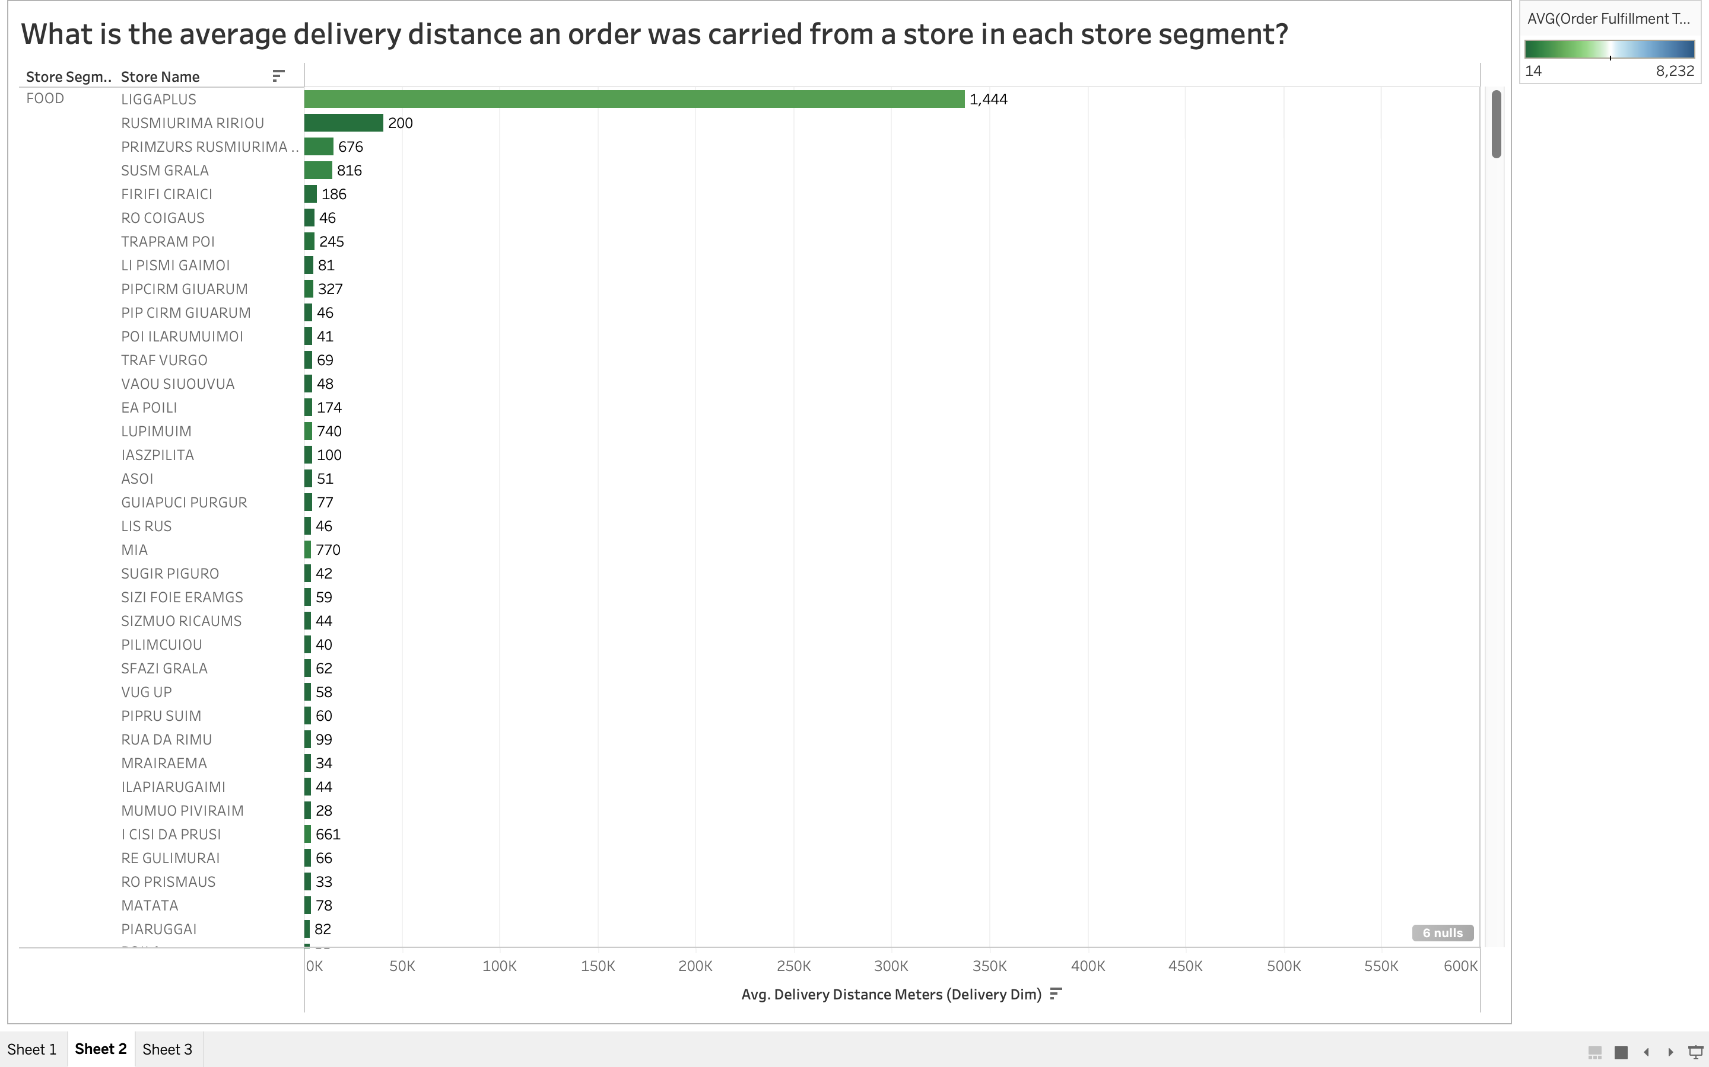
What is the average delivery distance an order was carried from a store in each store segment?

Slide 58
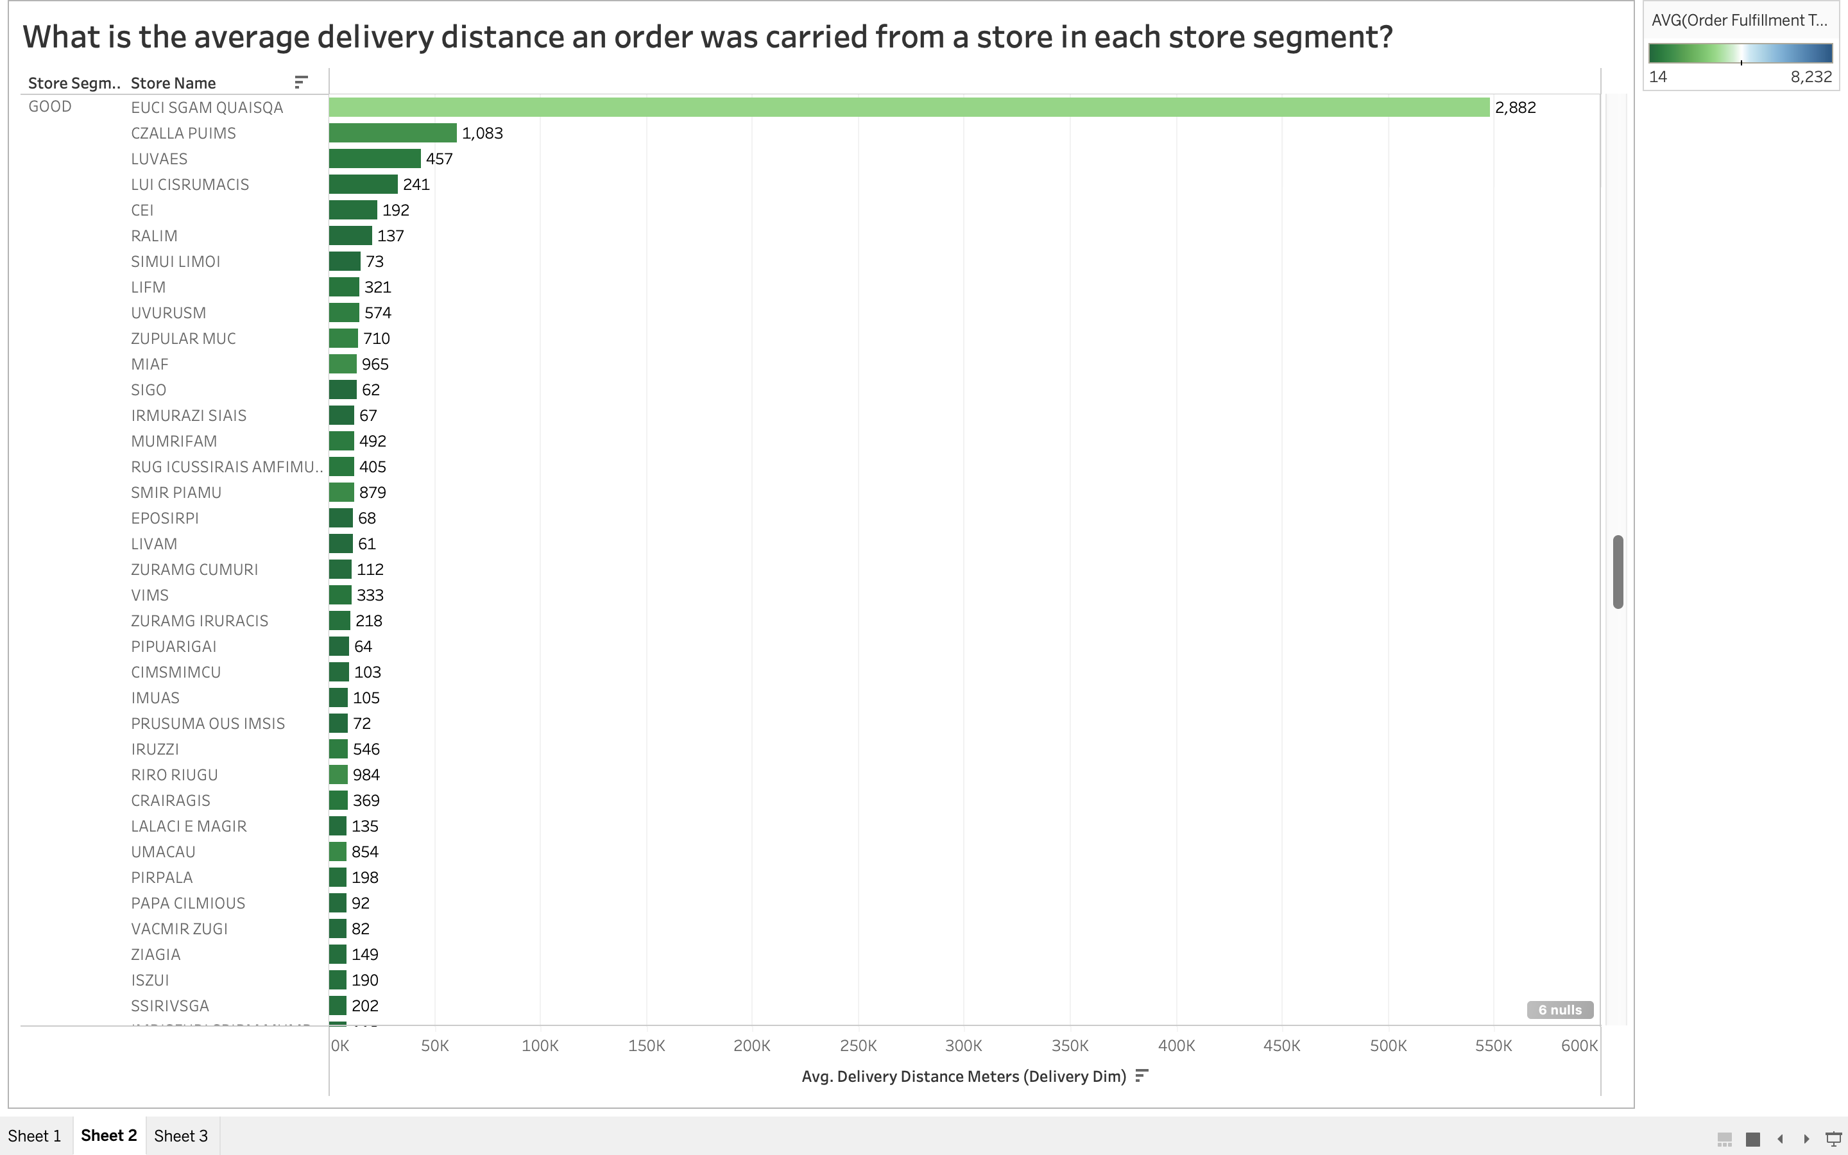

Slide 59
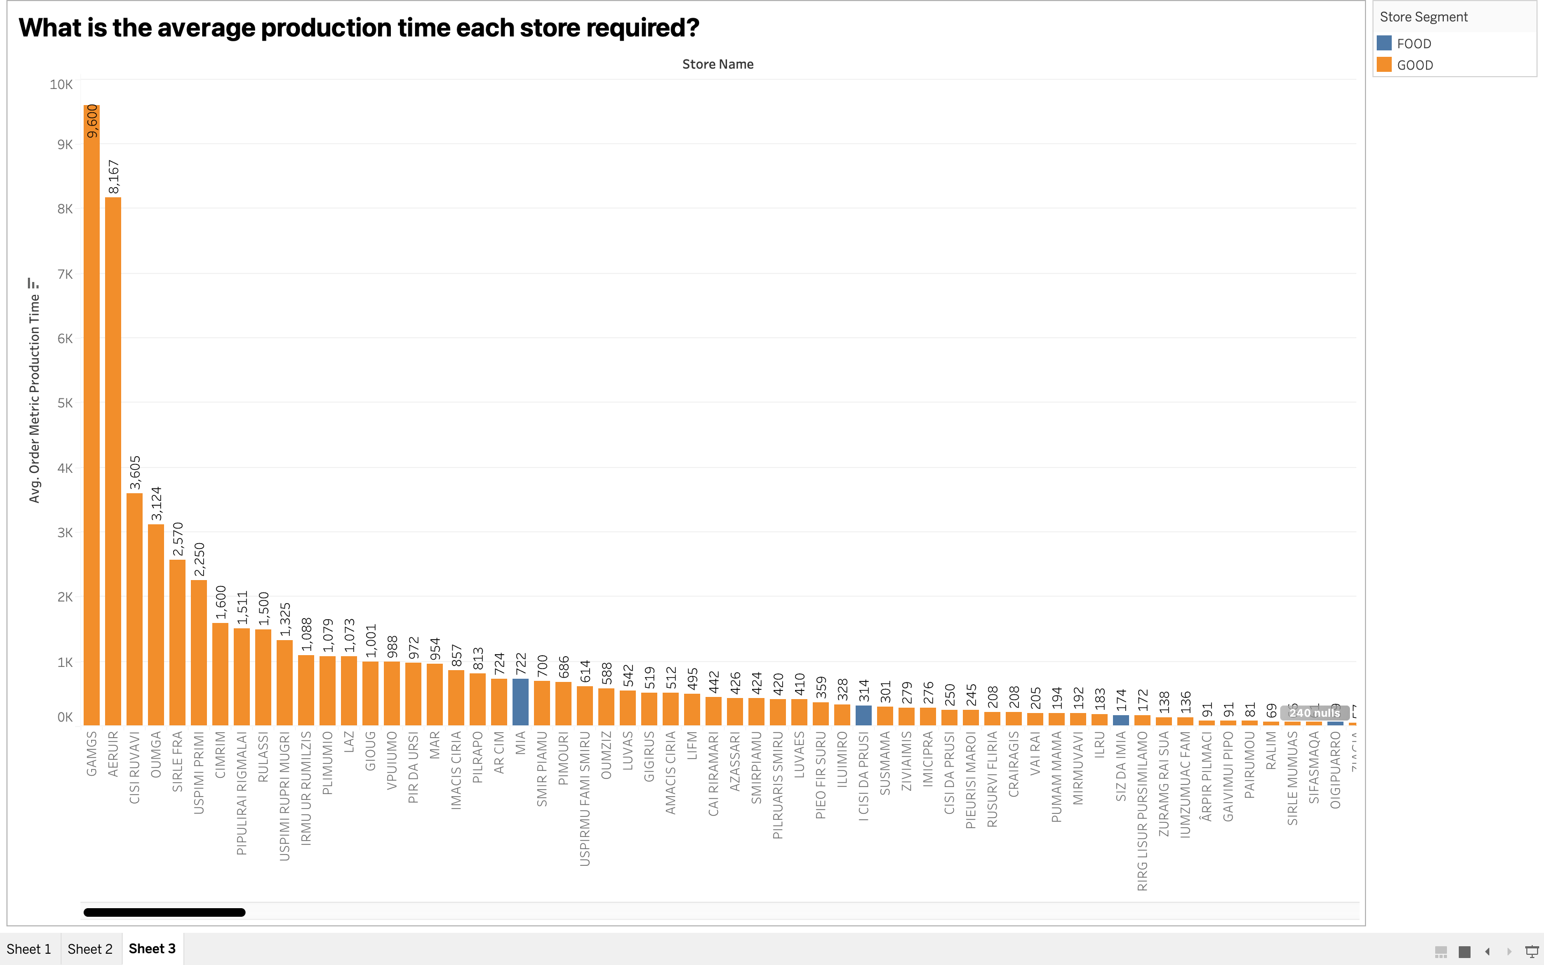
What is the average production time each store required?

Slide 60
Thank You!!!

